Slide 1

Rapid Re-Housing Workshop
Long Island, NY Continuum of Care
May 23 + 24 2018
Ashley Mann-McLellan

Slide 2
Overview of the Day
Agenda
  Stress and Homelessness
  Overview of RRH- Systems Lens
  Core Components of RRH
    Housing Identification
    Rent and Move-in Assistance
    Case Management and Services
  Data & Evaluation
  Action: Structures to Enhance Good Practice

Slide 3
Guidelines for Today
Respect everyone’s remarks, ideas, input
Parking lot any rabbit holes
Listen to understand
Share freely to foster innovation

Slide 4
Introductions
Ashley Mann-McLellan
Technical Assistance Collaborative (TAC)
Your Turn…
Name, Org, Role, Type of RRH Funding

Slide 5
Who Is Here? Quick Show of Hands!
    RRH Program Front Line Staff
    RRH Program Manager/Director
    Executive Director
    SSVF-funded RRH
    HUD-funded RRH
    Other-funded RRH
    CoC/ System Leadership
    Funders
    HMIS/Data Analysts
    Other

Slide 6

A Word of Caution…

Slide 7

The Brain Power in the Room

Slide 8

Next Two Days: A little bit of everything

Slide 9
Note About Role & Content
    Content will have both a systems planning lens and will include tips for frontline and program staff
    Funders/system planners can use both system and program-level tips to inform system design and vice-versa

Slide 10
About the Rapid Re-housing Institute (RRHI)
Goals for the RRHI
Improve and standardize RRH practice across your community
Align RRH programs from all funding streams with national best practice standards
Implement RRH in a systemic way
Notes:
Q and A (time permitting)

Slide 11
Quick show of hands!
  Expert in RRH
  Very familiar with RRH
  Somewhat familiar with RRH
  Just learning/starting an RRH program
  I don’t know anything about RRH

Slide 12

Building on Your Expertise
2
Notes:
About the RRHI:
Goals
Partners
Tracks

Slide 13
ACTIVITY
Think about a time in your life when:
You faced a very difficult situation
It was critically important
You didn’t feel you had much (or any) control
The problem(s) continued for more than a month
Try to remember how you felt and acted.
Write down words that describe your feelings and behaviors at that time.
You will not have to share!

Slide 14
The Impacts of Stress
Stress affects executive function
Executive function includes neurocognitive processes that enable us to:
Solve problems
Modify behavior in response to new information
Follow through with plans
Override impulsive behaviors and emotions to engage in goal-directed behavior
Remember and retrieve important information
The cognitive abilities we need to resolve a crisis are the same abilities that are diminished during that crisis!

Slide 16
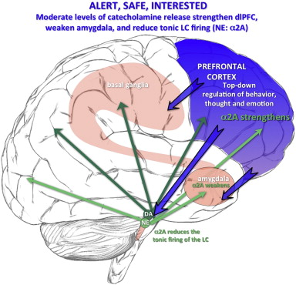
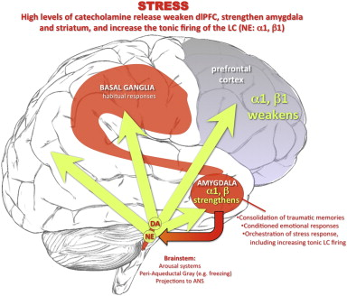
Stress Affects Your Emotions, Thinking & Behavior
Your Brain, Feeling Good
Your Brain on Stress!
Source: Effects of stress exposure on prefrontal cortex… (Arnsten, Raskin, Taylor, Connor 2014)
Notes:
This morning we looked at the normal cognitive, emotional and behavioral responses to severe, prolonged stress. But why do we have these reactions to stress? Why can’t we just control our feelings and behaviors?
Your brain works very differently when you are under stress. It’s a survival mechanism, preparing you for flight or fight.
(POINT TO FIGURE ON LEFT) When the environment is relatively stable, your prefrontal cortex is primarily in charge (POINT TO BLUE-SHADED AREA). This is the part of your brain that THINKS about what to do, here and now and--importantly also in the future.
(POINT TO FIGURE ON RIGHT) When you are under stress, the signals of the PFC are over-ridden by the amygdala and basal ganglia (POINT TO RED AREAS). This is the emotional, impulsive part of your brain—the part that wants to run away or to pick a fight.
This sets up a cascade of neuro-hormones that focus on survival. When a lion is charging, you don’t want a pre-frontal cortex pausing to wonder “How fast is that lion going? What’s his trajectory? How fast can I climb that tree? Do lions climb trees?” So rational thinking is over-ridden by spurts of anger and fear, muscles that tighten, digestion stops, blood pressure goes up—all to ensure you can fight, flee and survive injury.
Because the pre-frontal cortex is disengaged, cognitive functioning is reduced. In particular, what we call executive function…

Slide 17
RRH Services and Stress
Stress overload can impact the ability of a person experiencing homelessness to:
Pursue, obtain and/or keep a job
Independently apply for benefits/other
Construct and follow a budget
Control discretionary spending
Anticipate the consequences of actions and choices
Importance of low-barrier admissions processes
S/He may need more time or support to reduce stress.
Notes:
Because of the impact of the stresses they have been facing, they may have difficulty doing exactly what they need to do to resolve barriers to housing stability.
READ
So, people may have difficulty with things they would be able to do independently when they are NOT stressed. And until their stress resolved, they may need more direct assistance.
You will also need to be careful about overloading too many goals or action steps into one Plan. Use several shorter-term, simpler plans while assessing how much the person can do on their own.

Slide 18
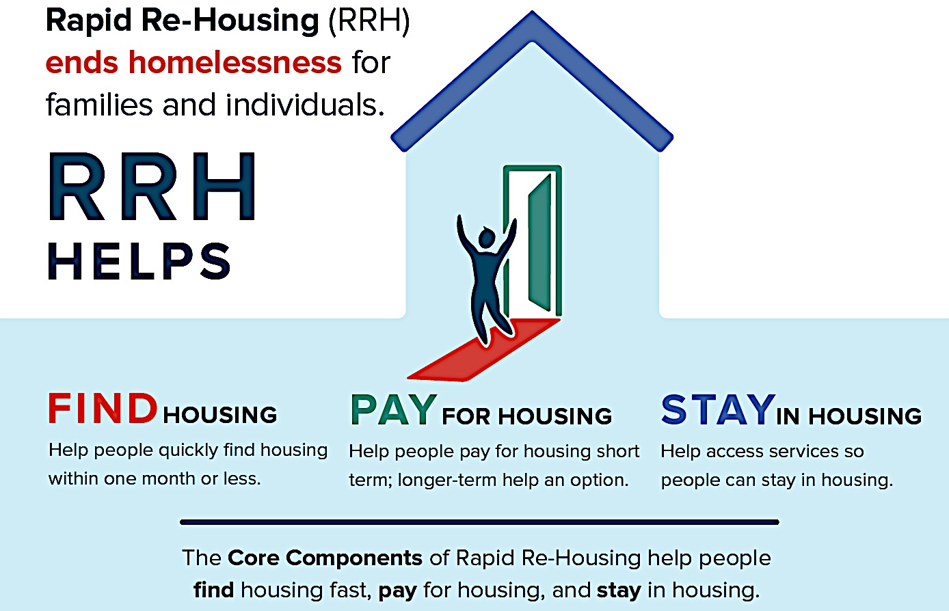
Rapid Re-housing
A Systems Lens

Slide 19
What Is Rapid Re-housing (RRH)?
Rapid re-housing is an intervention designed to:
Help individuals and families to quickly exit homelessness,
Return to housing in the community, and
Not become homeless again in the near term.

Slide 20
What does RRH do (and not do)?
Rapid Re-Housing Does
Rapid Re-Housing Does Not
Reduces the length of time people experience homelessness
Minimize the negative impact of homelessness on their lives
Assist people to access resources that can help with long term goals – if they choose
Eliminate poverty
Assure people will have affordable housing
Protect people from impact of life losses or difficult choices
Eliminate housing mobility

Slide 21
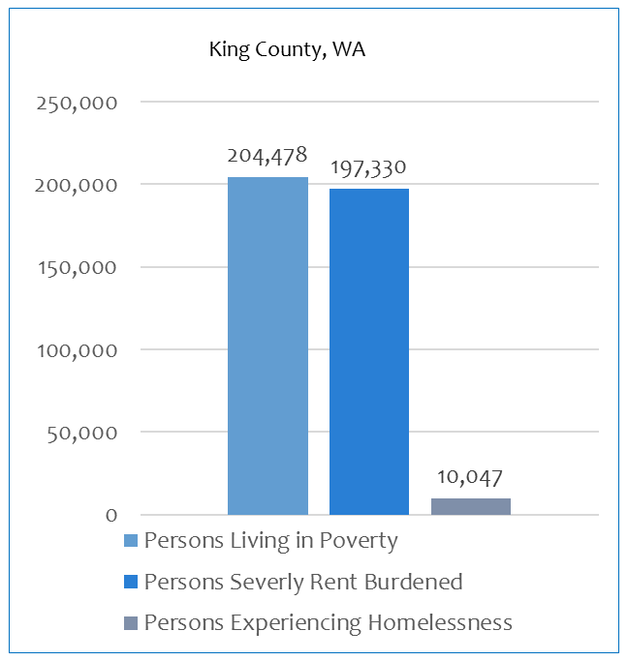
RRH: Strengths-Based Approach
Households experiencing homelessness are not significantly different than other poor households
Most poor households do not become homeless
Most households only need a light touch of assistance to exit homelessness
Some sub-populations in poverty have a higher incidence of homelessness(e.g., veterans)
Homeless
At-risk
In poverty
20
Notes:
We often worry that people will become homeless again after RRH because it is time limited assistance and people are still very poor when RRH assistance ends. However, data shows that most people can make it with a light touch of RRH assistance and not return to homelessness.
Even though a household is struggling with homelessness, homeless households look similar to very poor households. Most households struggling with poverty do not become homeless.
As you can see from this census and homelessness data from King County, WA, the number of people living in poverty (left) and the number of people who are severely rent burdened is MUCH greater than the number of people who experience homeless. This indicates that most people who are experiencing poverty, even those who are paying over 50% of their income to rent, do not become homelessness, even though they share similar characteristics to households that are homeless. In other words, most people who are poor do not become homeless so we shouldn’t expect that most people who are off RRH assistance and still poor will become homeless. This perspective also does not build on a household’s strength and resilience.
Note – some subpops have a higher incidence of poverty – like veterans – so plan accordingly when working with certain populations to support them in staying housed.

Slide 22
RRH: It Can Work for Anyone!
So, is Rapid Re-housing for everyone? (Yes!)
Rapid Re-housing works for many types of households/sub-populations
  Families
  Individuals
  Youth
  Veterans
  Survivors of Domestic Violence
  People experiencing longer term homelessness
No research has shown predictors who will and will not be successful in RRH
We can’t “assess” client resiliency in RRH

Slide 23
RRH: It Can Work for Anyone!
Leads communities to develop very low-barrier RRH admissions policies
No added criteria to get into an RRH program such as
  Minimum income
  Lack of criminal background
  Good credit
  Good landlord history
  Lack of DV history

Slide 24
A Systemic Approach to Rapid Re-housing: It Takes Work
To be most successful, RRH practice should also be implemented in a standardized way, however it is funded
Good RRH requires training, high standards of practice, skills, and strong relationships with the community – landlords, other programs, systems of care
RRH is something that agencies need to specialize in so they can do it well
A systemic approach will promote standardized practice and high performance from providers

Slide 25

Research, Outcomes, and Data
29

Slide 26
RRH: Outcomes
Increases exits to permanent housing
Decreases length of shelter stay/homelessness
  Reduced length of shelter stays frees up crisis beds for others in need
Reduces returns to homelessness
Increases system flow
30
Notes:
When implemented well, RRH will help your system get these outcomes.
We will discuss the concept of “system flow” later this afternoon (how quickly the system moves people from homelessness to housing)

Slide 27
National Data Trends
SSVF- Vet Homelessness 47% (2010-2016)
  25% Recidivism Rate (2015 and 2016 Annual Reports)
State of CT RRH Evaluation
  11% Recidivism Rate after 2 years in RRH
Los Angeles RRH- 2016 Dashboard
  26% exited to a temporary-in-nature destination
Seattle/King County Dashboards
  Average of 10% Recidivism rate after 1-2 years in RRH
Phoenix- 250 RRH Initiative (includes chronic and long term stayers)
  27% Recidivism Rate after 1-2 years in RRH
  No difference in outcomes between chronic and non-chronic

Slide 28
Questions?

Slide 29
RRH in a Crisis Response System

Slide 30
A Systemic Approach to Rapid Re-housing
In an effective crisis response system, resources and programs align roles and activities in a coordinated way around the common goal of helping people to quickly exit homelessness
8
Notes:
For RRH to be most effective, it should be implemented system-wide and aligned with the other components of an effective crisis response system so that all interventions have the goal of helping people quickly exit homelessness.
So, in an effective system, we have not only designed all of our programs and models around that goal, but the whole system’s resources and programs align roles and activities around this central goal to re-house people quickly.
And the system’s programs are coordinated to achieve that goal, whether they are an RRH program or not.
We will talk a lot more about these concepts over the next two days.

Slide 31
What is a System?
Inter-dependent parts
Regularly interacting
With a defined set of resources and practices
Working together
To achieve a common goal
72
Notes:
First, it might be good to define what we mean by “system”.
A system brings together many inter-dependent parts. They aren’t all doing the same thing. They have different roles and responsibilities.
In an effective system, the parts are working together within a defined set of resources and practices.
The system knows where its boundaries are, what resources it has to work with, and what its primary methods and practices are. Those things are aligned and working together towards a common goal.
In our case, the common goal is to house people who are experiencing homelessness quickly

Slide 32
What is System Flow?
An efficient and coordinated process that moves people from homelessness to housing as quickly as possible.
73
Notes:
A description of the way a crisis response should move people from homelessness to housing as quickly as possible

Slide 33
A ”Stuck” System:
Unchanging or increasing number of unsheltered people
Waitlist for shelter
Long lengths of stay in shelter (more than 30 days)
High percentage of exits from shelter back into homelessness
Average length of homelessness is not decreasing
Long waitlists for RRH, PSH
No diversion strategy in place
74
Notes:
A system that does not have good system flow is stuck. A stuck system does not move people from the streets or shelter quickly into housing. A stuck system often looks like this:
High unsheltered population
Waitlist for shelter
Long lengths of stay in shelter (more than 30 days)
High percentage of exits from shelter back into homelessness
Long waitlists for RRH, PSH
No diversion strategy in place
How many of you feel like your community has a “STUCK” system?
(The animation on the next three slides will simulate this concept)

Slide 34

A “Stuck” System
Unsheltered
Sheltered
Housed
45
44
49
43
75
74
79
44
73
45
46
30
74
75
47
76
48
77
unsheltered +
sheltered =
78
75
Notes:
Animation (let it play for a few seconds):
Here is a very simple representation of a system that doesn’t have optimal system flow – it is stuck. As you can see, on the left are people who are homeless and living on the street or in some type of unsheltered location. In the middle, we can see people who are in shelter beds. On the right, are permanent housing units. The animation shows new people are becoming homeless. People are moving from the streets to shelter as well as to housing. And people are moving from shelter into housing when there are open spots. Some people may go back into homelessness, though this isn’t shown here.
On the bottom, you can see that the number of people experiencing homelessness is going up because the inflow of people becoming homeless is higher than the number of people that are getting housed. (People are becoming homeless at a faster rate than the system can house people.) Also, the people with the sad faces represent “long-stayers” – people who are stuck in shelter for long periods of time because they don’t have a way of getting out to housing. This system is stuck.

Slide 35
Adding More Shelter Capacity
Unsheltered
Sheltered
Housed
Add shelter capacity
45
34
33
30
28
29
29
30
45
31
75
30
32
30
73
74
74
75
76
79
77
unsheltered +
sheltered =
78
76
Notes:
Animation (let it play)
When you have a lot of people who are homeless in your system, it is common to think that adding more shelter will help the problem. As you can see here, the number of homeless people still increases. Why? Because if you don’t increase housing capacity, people who are in shelter still have no way to exit out of homelessness.

Slide 36
Adding More RRH Capacity
Unsheltered
Sheltered
Housed
Add RRH capacity
34
64
40
70
45
43
41
41
75
73
71
71
42
71
40
42
30
72
70
38
72
37
68
41
67
40
39
70
34
69
39
69
38
68
32
62
33
64
38
63
32
68
33
62
35
63
36
65
34
66
36
64
38
66
36
unsheltered +
sheltered =
68
66
77
Notes:
This system has added more RRH capacity. This allows there to be more people flowing through to housing. Also, because RRH is a short-term crisis intervention, it is important to note that these “units” will open up every 6-12 months so new people can get that housing assistance. This creates good system flow. People are no longer getting stuck in homelessness for long periods of time.

Slide 37
Characteristics of an Effective Crisis Response System With Good System Flow
Prevention of or diversion from homelessness when possible
Rapid identification and engagement of people experiencing unsheltered homelessness to connect them to crisis services
Quick, accessible pathways to shelter and other crisis services with short stays in shelter
Rapid connection to permanent housing for all sheltered and unsheltered people, with priority on most vulnerable
78
Notes:
In an effective crisis response system, each part should play a specific role focused on the overall goal of stabilizing people experiencing homelessness in housing as quickly as possible.
Here are characteristics of an effective crisis response system with good system flow.

Slide 38
Characteristics of an Effective Crisis Response System With Good System Flow
Enough rapid re-housing and other housing interventions to match the needs of people in a community to decrease number of people experiencing homelessness and the average length of homelessness across the system
Utilization of long-term and intensive resources like PSH and vouchers reserved only for small number of people who most need those to exit homelessness
Strong connections to internal and external system partners, services, and mainstream agency benefits and networks to promote longer-term housing stability
79

Slide 39
The Connection:
Scaling Up RRH & Coordinated Entry

Slide 40
Bring RRH to Scale
Why?
Scaling up RRH is a key feature of communities that have seen significant decreases in their homeless numbers:
    Houston
    Virginia
    Salt Lake City
    Mercer County, NJ
118
Notes:
Another reason why you should bring RRH to scale – it helps to impact your homeless numbers when you made a bigger investment in it. Scaling up RRH is a key feature of communities of places that have seen significant impacts in their homeless numbers – Houston, VA, SLC, Mercer County, NJ. They put an emphasis on RRH and seen significant impacts from it. They allocated more resources to it to make it a larger component of the system. So we really urge you to understand how you’re investing in RRH vs other parts of the system.

Slide 41
Bring RRH to Scale
How?
Look at the whole system and identify where RRH is needed
Take stock of your system’s needs, strengths and gaps
Assess your system’s investments and existing resources
Allocate resources to match the need
119
Notes:
So, how do you approach bringing RRH to scale? First, you have to back up and look at the whole system in order to know what gaps exist, what resources are being used, what can be reallocated, and how the system is performing.

Slide 42

Sample Gaps Analysis
2700 Expected to Self Resolve
Data Sources
Draft 2017 AHAR data (unduplicated Inds & family households in ES and TH)
Self Resolve- Approx 22% of newly homeless self resolve per local study
Units- 2017 HIC + est. 600 mainstream units
Note: Family State RRH is not included in inventory at this time due to limited data availability
1,900 hsg interventions per year
(current rate)
20% of need
Gap: 7,400 units
Need
3,230 hsg interventions
per year
(4,350-1,120)
845 YYA Point in Time (CUI 2016)
12,000 Households Homeless in FY 2017
12,000 Current Homeless – 2700 expected self resolve=
9300 Need a Housing Intervention/year
Notes:
#’s based on HMIS data of all YYA under 25 y/o who entered HMIS between 4/1/16 and 3/31/17

Slide 43
Bring RRH to Scale
  Gaps
  Along the way, look for “deal-breaker” gaps that bottleneck the system
    Ex. Lack of referrals
    Ex. Ineligible costs leading to deal breakers
    Ex. Lack of specialized housing search staff
  Is RRH or another intervention or service not being accessed because of an unnoticed barrier?
    Ex. Lack of buy in from crisis response staff
121
Notes:
Deal breaker gaps are gaps that bottleneck the system but are less obvious because they can be harder to see. Are there program vacancies but for a simple fix? One example is of a RRH program that would be at capacity except that they are lacking housing navigators to help match households to the subsidies and units. Another example would be an RRH program that uses a funding source that can’t pay for application fees, so households are waiting in shelter while they get that money together. These gaps can have easy fixes but cause bottlenecks to your system anyway unless they are solved.

Slide 44
Bring RRH to Scale
Braiding and Blending Funding
Funding sources have different restrictions so figure out which funds can be used
  If you can combine sources, you can move households through RRH services and have multiple sources address different core components of RRH
Make it seamless: the household being served should never feel the change in funding type
With sources braided, more households can be served and with a wider array of options
126
Notes:
Braiding or knitting funding sources is often a reality for RRH programs. SSVF was built to provide nearly every type of support a household might need to end homelessness and stabilize in housing. Other programs were pieced together over time and a lot of programs have money from different federal resources that don’t perfectly align. For example, one source might not allow for barrier debts to be paid for and another might. One source may only be usable for rental assistance for three months but the household being served needs four or five. And even small expenses like application fees might be coverable with private money. Design your system so different sources can be used in a smooth way that the household being served will not have to be worried about.

Slide 45
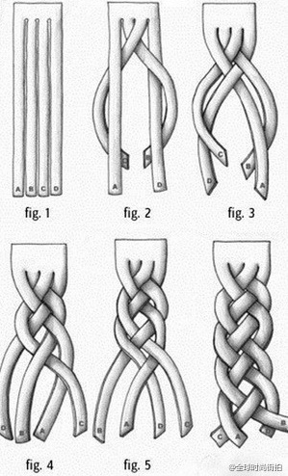
Bring RRH to Scale
Braiding and
Blending Funding
Braiding Funding
Lots of different funds are used for rapid re-housing
Funding streams may have different eligibility or reporting requirements
Tracking and accountability is maintained at administrative/systems level
One contract
127
Notes:
The difference between braiding and blending?
Blending funding:
Lots of different funds are used for rapid re-housing
Funding streams may have different eligibility or reporting requirements
Tracking and accountability is maintained at administrative/systems level
One contract
Braiding and Blending really helps to fund gaps for people who sometimes don’t fit neatly into program eligibility boxes (but does take an immense amount of administrative work) but makes the experience of the client much more seamless

Slide 46

Bring RRH to Scale
Braiding and Blending Funding
Blending Funding
Lots of different funds are combined into a flexible pool for rapid re-housing
One set of eligibility and reporting requirements
They are allocated to providers without specific requirements
One contract
128
Notes:
Blending Funding
Lots of different funds are combined into a flexible pool for rapid re-housing
One set of eligibility and reporting requirements
They are allocated to providers without specific requirements
One contract

Slide 47
Questions?

Slide 48
Progressive Engagement Across the System Using RRH
What is system-wide progressive engagement?
Progressive engagement (PE) is a system strategy to provide most or all people with just enough RRH assistance at system entry to help them exit from homelessness, while reserving intensive resources for people who are most in need of PSH and longer-term supports, in order to shorten the time people are homeless and help more people exit homelessness.
100
Notes:
We discussed program-level progressive engagement when structuring financial assistance.
Progressive engagement also describes a system strategy.
Progressive Engagement allows us to provide RRH to most people entering the system who need help to exit to housing
PE Assumes that most people can exit homelessness building on their own strengths with a light touch of assistance. If a household needs more support, provide more assistance. If a household shows a need for more intensive services after trying RRH one or more times, save intensive PSH and voucher resources for the small percentage of people who need longer-term support
(The system can prioritize people at the front end for intensive resources like PSH and vouchers as well, but you want to save some of those for the back end for when other things haven’t worked)

Slide 49
System-Wide Progressive Engagement
Coordinated Entry/
Diversion
Permanent Housing
Other Housing Subsidy
Shelter Entry
RRH $
RRH $$
RRH $$$
PSH
101

Slide 50
Progressive Engagement Across the System Using RRH
How?
Provide a light touch (RRH) to all people entering the system, offering more only when need arises
Provide just enough financial and services support needed to help people obtain and stabilize in housing
Provide a “backstop” of a deeper resource if RRH or other interventions aren’t working out (PSH, vouchers, other longer subsidies)
  System can match the small % of people with PSH and more intensive supports at system entry if they are eligible (e.g., chronically homeless) but should save some of these resources to provide a “back-stop” who show a need for more than RRH
102
Notes:
Progressive Engagement allows us to provide RRH to most people entering the system who need help to exit to housing
PE Assumes that most people can exit homelessness building on their own strengths with a light touch of assistanceIf a household needs more support, provide more assistance. If a household shows a need for more intensive services after trying RRH one or more times, save intensive PSH and voucher resources for the small percentage of people who need longer-term support
(The system can prioritize people at the front end for intensive resources like PSH and vouchers as well, but you want to save some of those for the back end for when other things haven’t worked)
Know eligibility for all system resources
Collect needed documentation
Have policies and procedures to be able to transfer people between funding sources and projects without making them move or making them homeless again

Slide 51
Progressive Engagement (PE) Across the System Using RRH
Why?
We want to try RRH for lots of households and PE helps use RRH efficiently to serve more people
But, we know it won’t work every time for every household
AND, we aren’t good at telling who at the front end is going to succeed
So, rather than screening people out at the front end, we should build our system to give people the opportunity to get RRH
Reserve the resources to provide that something deeper when and if what we’re trying isn’t working. But don’t think of all RRH as a bridge!
103
Notes:
Progressive engagement is the “backstop” that makes trying RRH with more households possible.
Common Myth/Concern – RRH only works for some people, and we don’t want to try it with most people because we are setting them up to fail. That makes people worse off.”
We know RRH works well for lots of people because of research and data we reviewed earlier this morning
We shouldn’t be afraid of trying it because most of the time, we are setting them up to succeed, not fail!

Slide 52
PE: Prioritizing for the Back Pocket Resources
Sample Approaches from Around the Country
Existing assessment tools that measure activities of daily living
Key factors such as…
  Previous length of time homeless
  Previous # of homeless episodes
  Previous returns to literal homelessness after RRH
  High rent burden (above xx%)
  Current lease violations; current rental and/or utility debt
  Presence of disability, severe service needs
103
Notes:
Progressive engagement is the “backstop” that makes trying RRH with more households possible.
Common Myth/Concern – RRH only works for some people, and we don’t want to try it with most people because we are setting them up to fail. That makes people worse off.”
We know RRH works well for lots of people because of research and data we reviewed earlier this morning
We shouldn’t be afraid of trying it because most of the time, we are setting them up to succeed, not fail!

Slide 53
Progressive Engagement Across the System Using RRH
Differences between PE at program-level and system- level:
  Program-level: Do periodic assessments within RRH programs before continuing support
  System-level: Deep resources like vouchers and PSH are able to step in when RRH has been tried (one or many times) and is not enough
    Coordinated Entry ensures system has some deeper resources “in the back pocket”
104
Notes:
A lot of places say they do PE, because they do periodic assessments within RRH programs before continuing support, and that’s great at the program level
But the strongest PE is at the systems level and involved multiple resources
We may give some PSH and vouchers right away through coordinated entry or shelter - –people who have extremely deep needs who have been in the system multiple times and they have been prioritized for those resources
But we also want to keep some of those deeper resources in our back pocket and we can offer after we tried the lighter touch approach of RRH, and use the deeper resources when needed, that allows us to serve more people, and not rely on guesses for who will and wont’ be successful
We build the understanding into how our system works!

Slide 54
The Core Components of Rapid
Re-housing

Slide 55
Core Components of Rapid Re-Housing
  Housing Identification
Rapid Re-Housing Case Management & Services
Rent and Move-In Assistance (Financial)

Slide 56
Core Components of RRH
RRH Case Management & Services
Housing Identification
Rent and Move-In Assistance
Not linear
Cannot work in silos
All three components do not have to be within one program but must be well-coordinated

Slide 57
Core Component: Housing Identification

Slide 58
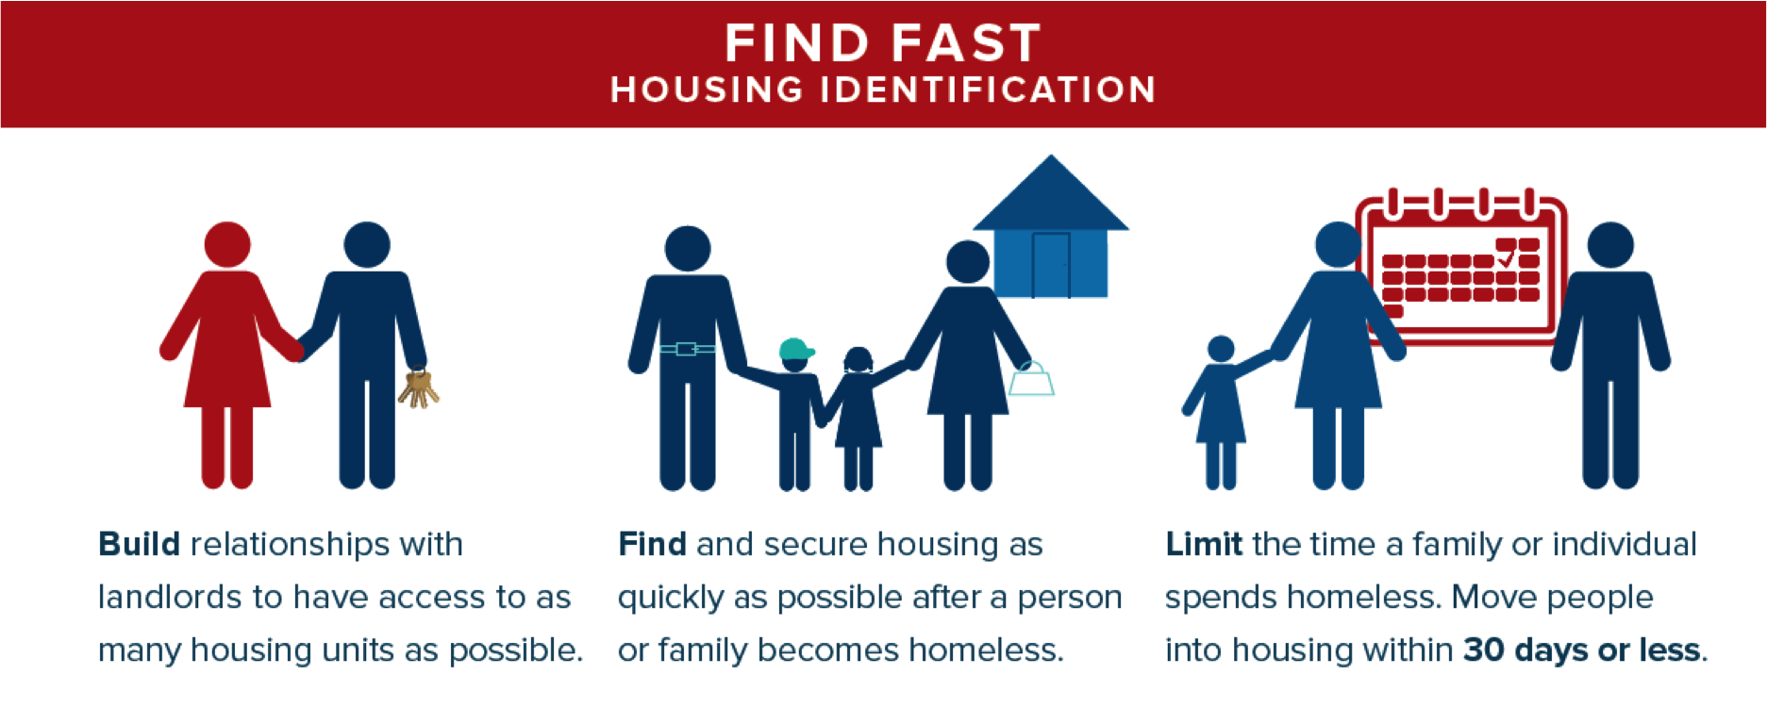

Slide 59












Four Things That Landlords Want
Good
Neighbor
Property Care
Comply with Lease
On-Time
Rent

Slide 60
Systems-Level
Landlord Engagement

Slide 61
Landlord Recruitment and Retention: Systems Approach
Centralize/Coordinate landlord recruitment
Build a centralized database on landlords
Coordinate all housing locators into one group that can share information on search and retention methods
Use common messaging and outreach methods
Use common incentives so that landlords don’t “program shop” for the best deal
Respond to landlords' concerns in a coordinated way (ex. google form)
System should create standards for “landlord engagement and care” for all RRH programs to use
Seek out developers with unit scale
Involve political persuasion
Hold landlord focus groups in a regular basis

Slide 62
Examples of System-Wide Landlord Engagement
Atlanta- Open Doors Atlanta
Massachusetts- New Lease
Boston- Landlord Guarantee Pilot Program
Washington D.C.- Budding landlord mitigation fund
Seattle/King County- Landlord Liaison Project
Central Florida Supportive Housing Program

Slide 63
Program-Level
Landlord Engagement

Slide 64








Landlord Recruitment: Leave No Stone Unturned
Word of Mouth Referrals
Direct Mail
Networking Meetings
Host a Landlord Event
Cold Calls

Slide 65
Finding and Keeping Landlords in a Difficult Market
Developing and maintaining landlord relationships must be someone’s full time job
Housing search is proactive and continuous
Program and staff ALWAYS do what they promise
Calls from landlords are returned quickly
Landlords are Your Second Client

Slide 66

Quick Tips: Finding Landlords
Housing Authority websites
Newspapers- subscribe; especially neighborhood papers
“Apartment for Rent” signs in buildings
Landlord/Realtor associations/Chamber of Commerce
Train your agency’s Board of Directors to recruit
Faith-based communities

Slide 67

Quick Tips: Finding Landlords
HUD Multifamily Developments
  Tax Credit Units
    “Shallow” subsidy, flat rent
  Market Rate Units
    No subsidy, market rate, typically FMR
Excel Database for Attendees

Slide 68
Quick Tips: High Rent Areas
First Placement May Not Be Last Placement
  Continue mainstream housing search while in unit
  Troubleshoot/transition plan with Client
Shared Housing
Placing Ads/Campaigns in Local Media
Train Your Board in LL Recruitment
Vacancy Listings Website for LL’s to Post

Slide 69
Staffing
Housing Identification Staffing:
Roles of Housing Staff vs. Case Managers
RRH Dedicated Housing Search Staff
Understands the needs and concerns of landlords
Identifies housing resources and continually recruits landlords
Makes the “business pitch” to landlords
Creates a pipeline of available units
Maintains relationships with landlords and housing partners
Has real estate background or other housing search experience

Slide 70
Ideas: Recruiting/Retaining Landlords
Piggy-back off existing events- Chamber of Commerce, Realtors’ Events
Political Persuasion
Using existing agency events to continually recognize landlords
  Galas, fundraisers, Board Events
Gift Cards with brochures
Heat Maps of Frequently Used Landlords
Mail Runs of those you wrote checks to in the last year

Slide 71
Ideas: Using Data to Recruit
# of security deposits returned after tenancies end
Eviction rate for the program
Rate of client engagement in services
Outcomes of increased income in your program
Rate of landlord complaints (or lack thereof)
# of landlord partners you work with
Length of time people stay in unit

Slide 72
Incentives for a Landlord Partnership
Cut checks fast and on time
Double damage deposit if/when needed for “risky” client
Risk Mitigation Fund for damages caused by tenant
Help with minor repairs
Steady referral source of new tenants; no need to advertise
Calls returned within one business day
Staff teach “good tenant” skills
If problems can’t be solved, assist tenant to move out without an eviction
Part of a mission to end part of the team
Annual recognition event, positive media exposure

Slide 73
Questions?

Slide 74

Marketing Your Program
Landlord “Speak”
Translate the benefits of working with you into Landlord Speak
Reminder: Landlords are not in our field.
Broad Terms = Less Compelling
  “Case Management”
  “Services”
  “Stabilization Services”
  “Follow Up”
  “Connection to Community Based Supports”

Slide 75
Marketing Your Program
Landlord “Speak”
Break it Down.
1.) In your groups, list a top question/concern landlords often have
2.) Break down the services/benefits/features of your programs to address those concerns; think brochure language
3.) Select a note taker and reporter to share to the group
4.) 15 Minutes

Slide 76
Marketing Your Program
Landlord “Speak”
Tips to Break it Down.
Centralized point of contact for the landlord
# of business days to return LL’s calls
Provide written character references ahead of time
  From other sources- you as the “houser” should only provide a neutral reference

Slide 77
Marketing Your Program
Landlord “Speak”
Break Down Supportive Services
  Home visits, office visits, budgeting, connection to health-related services, move-in costs, frequency of client contact
  Direct, scheduled check ins with landlords
  Be specific so landlords understand
Break Down Supports During Tough Tenancies
  $
  Connection to legal advice
  Soft landing for client
  HP Assistance when available
  Landlord in-services/trainings

Slide 78
Marketing Your Program
Landlord “Speak”
Additional Tips
  Obtain landlord references for your program or system
  Under promise and over deliver
  Importance of Training/Staff Expectations
    Staff must be trained and agree to adhere to any terms outlined in order to keep the relationship successful

Slide 79
Questions?

Slide 80
Program Operations
A Landlord Engagement Perspective
Create Program Designs with a Landlord Engagement Emphasis
Institutionalizes Landlord Engagement
  Assists with maintaining strong engagement in face of turnover

Slide 81
Program Operations
A Landlord Engagement Perspective
Written Policies to Foster Landlord as the Second Client
  # of Business days to return LL’s calls
  Reference Policy
  Back up contact if you’re out sick or on vacation
  Frequency of check ins with landlords
  Standard “script” of benefits your program provides

Slide 82
Program Operations
A Landlord Engagement Perspective
Written Resources to Onboard New Staff
  Go-to places to find landlords
  Warehouse of agency’s landlord’s contacts
  Homelessness prevention resources to support tenancies in crisis

Slide 83
Program Operations
A Landlord Engagement Perspective
Routine Program Activities
  Routine, proactive LL Check Ins
    Support the landlord
    Identify at risk households
    Note: ensure ROI’s cover this activity
  Track results of check ins
    Identify Landlord champions
    Identify Landlords in need of your assistance
    Track success with landlords to recruit additional landlords

Slide 84
Program Operations
A Landlord Engagement Perspective
Landlord Database
  Warehouse of landlord contacts to help staff tap into existing landlord relationships
    Screening Criteria
    Tenant Preferences
    Areas where properties are located
    Update vacancies in real time
  Culture of Sharing Landlord Openings
    Within agency
    With other agencies
    Goal- fill the unit with a homeless household

Slide 85
ACTIVITY : Large Group Discussion
Think about a time in your life when:
What ways has your program has incorporated landlord engagement into program operations?
Write down words that describe your feelings and behaviors at that time.
You will not have to share!

Slide 86
Questions?

Slide 87
System-Level
Shared Housing

Slide 88
System-Level Approaches to Shared Housing
Host home campaigns
  Community members provide shelter through extra room/accessory dwellings
  In return, flexible costs such as food, rent, etc.
  Agencies provide support to “hosts”
    Host meet and greets
    House rule/guideline templates
    Support to tenant to sustain placement
  Frequent target pops: youth, elderly
  Frequent “host” pools
    Faith-based community
    LGBTQ community
    Current college students- act as mentors to other youth
    Elderly hosts who need assistance around the house

Slide 89
System-Level Approaches to Shared Housing
Apps to identify shared housing opportunities
  Apps for shelter guests to match to each other as roommates (LA, in development)
  Apps for hosts and people seeking hosts to match to each other
    Ex. Nesterly
System culture shift re: roommates
  Incorporate shared housing questions on uniform assessment tools
  Incorporate questions on any program intakes

Slide 90
Program-Level
Shared Housing

Slide 91
Program-Level Approaches to Shared Housing
Design of Shared Housing Parameters to Promote Success for Tenants
  Orient staff to benefits of shared housing
    Increased neighborhood choices
    More dispensable income (rent portion will be lower)
  Strive for separate leases between landlord and each roommate
  Each person should have own personal space in unit
  Strive for separate case managers for each roommate
  Stabilization must have an emphasis on shared living “how-to”
Other Programmatic Approaches
  Choice of roommate is fostered
  Shared housing is offered at any and all points of participant enrollment
  Data matches, regular meet/greet groups to identify potential roommates

Slide 92
Note re: HUD Habitability/Shared Housing
HUD CoC RRH Funding
  Subject to Housing Quality Standards (HQS) and local codes
  Must have at least one sleeping room or area for every 2 individuals
    May be a bedroom, living room
  Parents may share a room with child
  Children of opposite sex may not be required to share rooms
  Each CoC household must have own lease
  Check HQS for complete guidelines
HUD ESG and SSVF Funding
  “Adequate space and security for their belongings and a place to sleep”- defers to local codes
  Each household must have own lease
  Check Housing Habitability for complete guidelines
Subject to FMR/Rent Reasonableness
FMR Room = 75% of 0 bed FMR
FMR Shared Hsg = FMR for family unit size or pro-rata FMR, whichever is lesser
Pro-rata = # of bedrms participant will occupy by total bedrms (1/4 of 4 bed FMR)
CoC RRH may go up to rent reasonableness; ESG cannot

Slide 93
Small Group Discussion:
Shared Housing
In your small groups…
  Flip chart strategies to foster shared housing
  Ideas may include:
    Strategies you already employ
    New ideas you have
    Ways to match roommates
    Ways to communicate benefits of shared housing to RRH participants
    Ways to orient whole system to promote shared housing
    Questions you have on how to implement shared housing
  Select a recorder and reporter to share with the larger group

Slide 94
Efficiencies in Housing Search Process

Slide 95
Ways to Speed Up the Housing Search
Some Programs are looking at:
  Required intake documentation- paring down to only funder requirements
    Enrolling clients on same day as intake when possible
  Increasing intensity or duration of meetings with housing search participants
  Re-orienting caseloads based on housing search expertise
  Incorporating housing search in every appointment
    Eliminating a linear, step by step process
      Linear Process Example: First intake, then documents, then search begins

Slide 96
Small Group Discussion:
Housing Search Efficiencies
In your small groups…
  On a flip chart, map out all of the steps a client takes to enroll in your program and begin housing search
  Mapping may include
    Referral processes
    Required intake paperwork
    Required interviews/intake meetings
    Mark the point where your program begins housing search
    Frequency of housing search meetings
  Are there ways to condense activities or pare them down?

Slide 97
Questions?

Slide 98
Program Leadership Session

Slide 99
Debrief/Action Planning
Questions/Thoughts?
Action Planning
  Based on what you heard today, what are some strategies you want to work to implement in your programs in a 3 month period?
  Specificity will help the goal:
    Timeframe
    Specific goal/process/forms
    Point Person
    Leadership or meeting structure to complete
  Report Out
  Next Steps

Slide 100
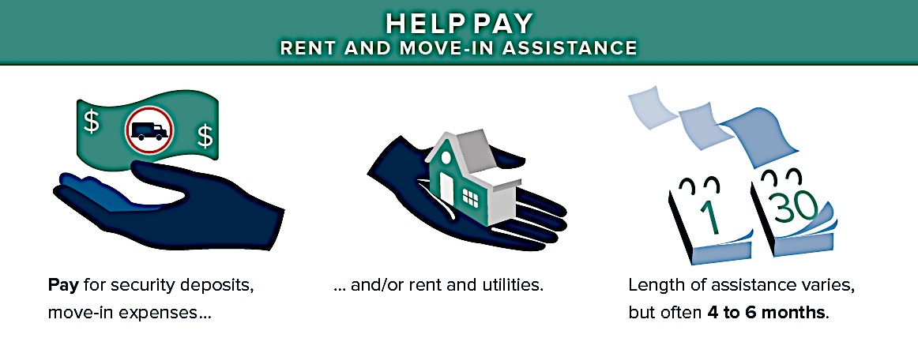
Core Component: Rent and Move-in Assistance

Slide 101

Progressive Engagement/Assistance
A Different Way of Thinking About Assistance
Previously: Advocate to get your client as much $$ as possible
Progressive Engagement/Assistance
  Lightest Touch Possible
  You can always add more

Slide 102


Progressive ASSISTANCE in
Rapid Re-housing
$
$$
$$$
Duration/Intensity
Notes:
Programs using a progressive approach regularly re-assess housing barriers. The focus is on the individual housing
plan and the barriers that have been identified in the plan, knowing that these might change over time. Case
management works towards addressing the housing retention barriers and closes a case when these barriers are
resolved and the household can assume full responsibility for their rent and other lease obligations. This means
that case management commitments vary by household. Assistance is provided on an “as-needed basis”.

Slide 103
A Progressive Approach
Programs do not impose a standard assistance package on all participants
Clients are first offered the least amount of assistance (financial and service) needed to end their homelessness, today
Support is scaled up, or down, based on individual household needs
Assume most can be successful with fairly limited assistance
Use flexibility of funding sources to tailor services

Slide 104
A Progressive Approach: Leading the Shift
Ensure housing plans are very housing-specific and concrete:
  Goals related to maintain housing and/or staying out of homelessness
  Small steps; avoid broad goals that can be overwhelming
Create forums for staff to learn about successful approaches within programs
Survey or ask clients about experience and/or what they need from the program
Use agency data to evaluate and adjust

Slide 105
Progressive Engagement (Financial Assistance)
Sample approaches
  Specified rent burden amount to close a case (ex. 60% and below are closed)
  Budget assessment every month to determine if any financial assistance is needed
  Standard upfront costs package (ex. 3 months assistance)
    Re-assessed as end of standard package nears for next increment of assistance
  Rent percentage schedule for participant (as long as its flexible to change as needed)
    Ex. Months 1-3 pay 40% of rent, months 4-6 pay 60% of rent, etc.
  Deep to shallow (ex. first 3 months deep to move up/out of homelessness; 21 months of very shallow assistance to make unit rent manageable
  Home-grown stability assessments
    Ex. Salt Lake City RRH Stability Conversation Guide
    Factors such as current rental debt, utility debt, current income, lease violations

Slide 106
Discussion
How do your programs structure financial assistance?

Slide 107
Questions?

Slide 108
Lunch

Slide 109
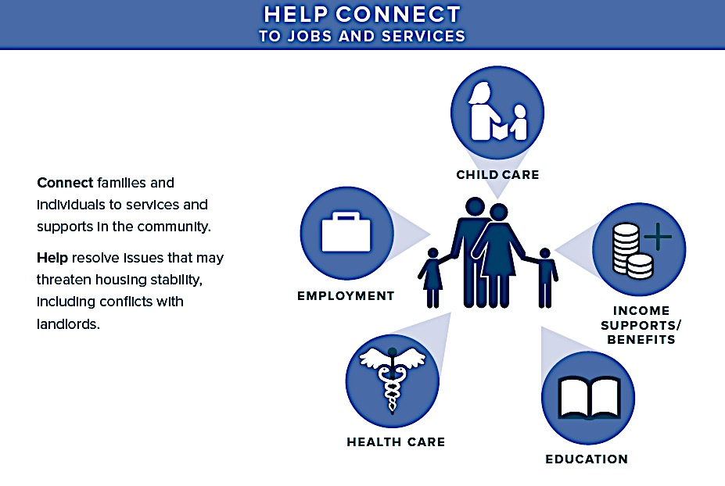
Core Component: Case Management and Services

Slide 110
System-Level
Supports

Slide 111
Mobilizing Partners
Gaining Support for RRH

Slide 112
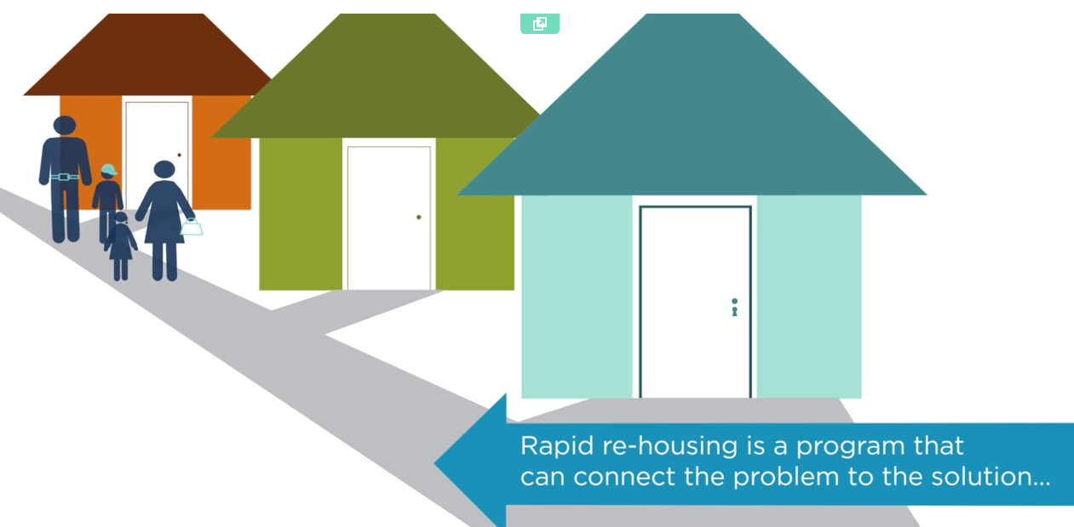


Available RRH Communications Resources
Video
Infographics
Resources
www.endhomelessness.org
139
Notes:
Just a few examples of exiting resources you can use that are readily available on NAEH’s website.
OR create your own!

Slide 113
Messaging: How to tell the RRH story to Partners
Create messages that are tailored to communicate with different systems:
RRH is a permanent housing intervention and…
  Housing promotes better health outcomes
  Housing lowers recidivism to jails and prisons
  Housing helps kids do better in school
165

Slide 114
Program-Level
Supports

Slide 115

Theme: Array of Service Options
Transitional Housing
Host Homes
Rapid Re-Housing
Problem-Solving Focus
Wellness
Housing Choice/Mobility
Participant Driven
“Make Yourself Useful”
Consumer Informed
Stress on Interdisciplinary Models in the community- Who else can assist?
Housing First approach
Use of a harm reduction approach

Slide 116
Case Management and Services: The Housing Plan
The client chooses goals; the case manager can assist with methods to achieve those goals (including, as needed, direct assistance).
Case plans are focused on obtaining and retaining housing
Case plans summarize the steps the case manager and the participant will each take to achieve the participant’s immediate and short-term goals

Slide 117
1. Each Plan is a Step Forward: Think Multiple Plans
Initial Emergency Needs and Housing Search Plan:
  Emergency health and safety needs
  Steps for housing search
Housing Retention Plans
  Sequence of plans, updated as goals are: achieved; added; are too ambitious and need to be scaled back; or when circumstances change
Exit Plan
  Follow-up options
  Plans for possible future housing emergencies

Slide 118
2. Plans Should be Limited in Scope
    PRIORITIZE! An important approach to stress management and the key to crisis intervention
    The focus of the plan is on housing
    Obtaining and retaining housing is tough enough!
    People can choose when and if (and with whom) to address other life issues and goals… later… when they are safely and stably housed

Slide 119
3. Plans Should be Reasonable
    What housing locations, characteristics and rent are reasonable in your local market?
    Given benefit levels, the local job market and the person’s work history/skills, what is a reasonable income goal?
    Given that significant or multiple personal changes are difficult at best (and nearly impossible under stress), what expectations are unreasonable goals for this individual at this time?

Slide 120
Housing Plan Engagement Strategies:
Harm Reduction & High Quality Services

Slide 121

“Harm reduction refers to policies, programs, and programs that aim to reduce the harms associated with the use of psychoactive drugs in people unable or unwilling to stop”
– Harm Reduction International
Definition

Slide 122
Harm Reduction- Housing World
Broader than use of psychoactive drugs
  Behaviors related to tenancies
  Justice-involved behaviors (may also impact tenancies)
Reminder for Housing Providers- Goal
  House and keep people housed

Slide 123
Principles of Harm Reduction
Accepts that problematic behaviors are part of our world and chooses to work to minimize its harmful effects rather than simply ignore or condemn them
Ensures that those we are serving routinely have a real voice in the creation of programs and policies designed to serve them

Slide 124
Principles of Harm Reduction
Understands drug use as a complex behavior and acknowledges that some ways of using drugs are clearly safer than others
Establishes quality of individual and community life and well-being – not necessarily cessation of all drug use – as the criteria for successful interventions and policies

Slide 125
Overlap: HF and Harm Reduction
  Housing First…
  Does not require people experiencing homelessness to address all of their problems
  Does not require progression through a continuum of programs before accessing housing
  Does not mandate participation in services before attaining housing or to remain in housing
  Views housing as the foundation for life improvement and places no requirements beyond those of a typical renter
  Services become more effective as people choose to participate as opposed to being mandated

Slide 126
Harm Reduction in Practice
Decrease the concentration and frequency of behavior
Find substitutes for a safer choice
Explore alternatives for means of recreation and problematic rituals surrounding behavior
Create a budget that includes drug use and other behaviors
Ensures safety of the individual and others in the surrounding area during problematic behaviors

Slide 127
Harm Reduction in Practice
Public Health – ex. seat belt laws
Advocacy – ex. needle exchange
Treatment – ex. Methadone programs

Slide 128
Harm Reduction in Practice
Tenant Shoplifting to Supplement Income
Sample Approaches
Harm Reduction to stress impact on tenancy
  Arrest/conviction may lead to x consequence for you and your housing
“Honest” budgeting to account for expenses
Connection to resources to minimize frequency of shop lifting

Slide 129
Harm Reduction in Practice
Tenancy Education
Shows tenant the boundaries of behavior
Remember to delineate difference between use and lease violations
Sample Approaches
Thorough lease review before signing and one month after
Basic Guide to Tenancy (repairs, when to call 911, cleaning)
  Vermont example- in cartoons, simple language (linked)

Slide 130
Harm Reduction in Practice
Basic Guide to Tenancy (repairs, when to call 911, cleaning)
  Vermont example- in cartoons, simple language (linked)

Slide 131
Hosts With the Most!
Visitors: A Common Tenancy Concern
Sample Approaches
Harm Reduction to stress impact on tenancy
Create or partner with respite beds
Use motivational interviewing to create a visitor “plan”
Troubleshoot communication approaches w/participant

Slide 132
Small Group
With your coworkers discuss the scenario:
Jemma is a mother of two children living in a unit assisted with rapid re-housing. You as the case manager notice she has had alcohol on her breath at the last few meetings. Additionally, when you’ve done your regular check-in with the landlord, he expressed that she seems to be having more company over and that foot traffic in the building has increased. She hasn’t violated anything in her lease that he knows of, but he is concerned about the change in her tenancy.
What would you do in this situation with Jemma?

Slide 133
Questions?

Slide 134
High Quality Services

Slide 135
High Quality, Voluntary Services
Staff are trained in approaches to continually build trust and work to engage clients in voluntary services
Creativity is encouraged
“Make Yourself Useful” -practical help
Services are optional for the tenant, not for the staff

Slide 136
It Takes A Village
High Quality Services Include An Array of Options
Forge Partnerships to Tap Into Expertise
Assertive Community TX Teams (multidisciplinary)
Formal Referrals to Detox/Respite/TX beds
Partnerships with Managed Care Orgs
  Health navigators to supplement case management
  Reimbursement Structures

Slide 137
Prescribed vs. Supportive Services
Ex. Abstinence-based recovery →to harm-reduction
  Activities- educate about lease responsibilities; assist with problem solving with client on how they can manage use while still being a successful tenant
Ex. Job search staff to broader financial counselor role
  Activities- real talk budgeting, connection to money management services (rep payee, vendor payments), income maximization, benefits maximization

Slide 138
Activity- Group Brainstorm
High Quality Services
  Brainstorm ways your program can increase the quality of the services you offer (15 mins)
    Creative Engagement Strategies
    Setting of Meetings
    Training needs for your staff
    “Make Yourself Useful”
    Building Trust and Rapport
    Celebrating Small Successes

Slide 139
Case Mgmt Strategies

Slide 140
SSI/SSDI Outreach, Access, and Recovery (SOAR)
A national program designed to provide assistance to homeless or at-risk adults to increase access to SSI and SSDI
SOAR trains case managers to be able to create a high quality application for disability benefits that are much more likely to be approved and approved much faster
Many RRH Programs have assured at least one staff is SOAR-trained

Slide 141
Income Maximization/RRH Integration
Some programs are building in income maximization expertise into staffing
Integrated into RRH design
Care team, or medical home model
  Team-based staff, rather than silohed referrals between staff
Staff trained in employment, benefits and in-kind resource navigation
Employing a “Work First” model
  Same principles as Housing First; very low-threshold; harm reduction-based

Slide 142
Natural Supports Mapping
Template to prompt staff to assist participants to map out natural supports, assets and navigate community-based resources
Possible approaches to natural support templates:
  Emergency contacts (known relationships and community-based)
  Mental health services (emergency, ongoing)
  Legal services
  Medical care, pharmacy
  Crisis plans (health, violence, substance use, landlord/neighbor dispute)
  Community connections (faith-based, childcare, friends, family, community centers)

Slide 143
CTI & RRH- A framework for Case Management
Common sentiment- use progressive engagement and only provide robust services if displayed need…
Shift in thinking- gear participants up for success by providing thorough case management to connect participants to community to promote tenancy success
Critical Time Intervention:
  Six-month, three-phase model with a defined beginning, middle, end
  Emphasize active linking with services and supports that will persist after intervention ends
  Limit focus to factors that directly influence housing stability, tailored to individual clients
  Frequent, group-supervision is emphasized

Slide 144
CTI & RRH- A framework for Case Management
1.) Housing ID/Build Rapport
(flexible timeframe)
2.)Housing Plan; ID Resources and begin connecting
(2 mos/Weekly)
3.) Test Resource Access
(2 mos/Biweekly)
4.) Complete transfer to other services
(2 mos/Monthly)

Slide 145
Sample CTI/RRH Approach from state of CT’s RRH Programs
 | Pre-CTI | Phase 1: Transition | Phase 2: Try- Out | Phase 3: Transfer
Time frame/Intensity of Contact | Flexible | 2 Months/Intense Weekly | 2 Months Moderate Bi-weekly | 2 Months/Low Monthly
Objective | Housing Location/Move in; Begin CM Assessment and Housing Plan | Complete Housing Plan; Identify Resources and connect client | Monitor resource impact and client access | Complete transfer of services to the community
Action Steps | Negotiate Lease Educate/Advocate Relationship Building | Accompany client to appointments, follow up to ensure connection | Make adjustments to plan in collaboration with client | Meet with new service providers or others in the support system; reflect on work with client
Strategies | Take opportunities to teach/model housing location process; present services as a resource, not an obligation | Do advance work of creating resource networks | Empower client to do what they can on their own; create alternative plans if necessary | Reduce involvement gradually and inform client early on about the length and nature of CM support

Slide 146
CTI & RRH- Challenges To Overcome
Quick Housing ID/Simultaneous Rapport Building
Ideally robust clinical supervision
  Capacity Issues Within RRH Programs
  Some Places Looking at more group-style learning
Lack of Knowledge/Partnerships of Community-Based Supports

Slide 147
Questions?

Slide 148
Break

Slide 149

Making It All Stick
Data/Benchmarks to Measure Progress
Capacity Building
Standardization
Action Planning Next Steps

Slide 150
Evaluating and Improving Rapid Re-Housing
147
Notes:
We have just discussed how to standardize practice.
How do you actually evaluate and improve practice?

Slide 151
A Systemic Approach to Rapid Re-housing
To be most successful, RRH practice should also be implemented in a standardized way, however it is funded
Good RRH really requires training, high standards of practice, skills, and strong relationships with the community – landlords, other programs, systems of care
RRH is something that agencies need to specialize in so they can do it well
A systemic approach will promote standardized practice and high performance from providers
9
Notes:
Also, to be most successful, RRH practice should be implemented in a standardized way across all programs, no matter how the RRH is funded – whether it is SSVF, ESG, COC, DOJ, or some other funding stream. We will spend a little time on RRH practice when we go over the core components today, but the practice track is really focuses on how to have excellent RRH practice in all RRH programs. The system track will focus on how to build a system that makes RRH a primary strategy to end homelessness for most people.

Slide 152

A Systemic Approach to Rapid Re-housing
Standardizing best practices in all RRH programs is particularly important for RRH to be effective in
very high-cost, low-vacancy markets
152
Notes:
Ask audience by show of hands:
How many people here have a tough housing market in their community?
Ensuring that all RRH programs are offering best practice RRH is especially important in a high-cost, low-vacancy housing market because you need highly skilled staff offering excellent housing search and stabilization services to compete in the market
Also, as you probably know, having each program have to fend for itself in a high-cost, low vacancy market is particularly difficult for a host of reasons, including competing for landlords, not having the support of system partners to ensure housing stability, and not having enough resources to provide landlord incentives.
So, having a coordinated systems approach to coordinating housing search is really important in these markets. More on this later.

Slide 153
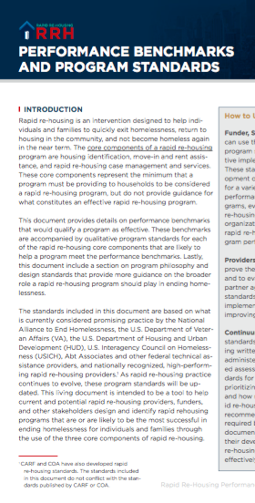
National Performance Benchmarks and Program Standards
Standards for RRH Core Components and program philosophy and design
Provide performance benchmarks for RRH
Based on what is currently considered best practice
Endorsed by VA, HUD, USICH
National Alliance to End Homelessness
  www.endhomelessness.org
Notes:
In 2016, The National Alliance to End Homelessness published the RRH Performance Benchmarks and Program Standards, created with Abt Associates, informed by providers across the country, and adopted by the VA, HUD, and USICH. The purpose behind the standards is to provide details on both what a rapid re-housing program should achieve and what the programs staffing, policy and activities should be in order to be considered an effective program. The document also provides performance benchmarks on three essential areas of performance and qualitative program standards for each of the rapid re-housing core components that are likely to help a program meet the performance benchmarks.
The performance benchmarks and standards are based on what is currently considered promising practice by the National Alliance to End Homelessness, the U.S. Department of Veteran Affairs (VA), the U.S. Department of Housing and Urban Development (HUD), U.S. Interagency Council on Homelessness (USICH), Abt Associates and other federal technical assistance providers. And, they were developed with input and feedback from nationally recognized, high-performing rapid re-housing providers.

Slide 154
How to Use the RRH Standards
Funder, State Leaders, and Coalitions
Development of Requests For Proposals (RFPs) for a variety of funding streams
Set performance and outcome goals for programs
Evaluate applications for new rapid re-housing programs
Review current program performance
Providers
Use standards to improve their own rapid re-housing practice and to evaluate possible rapid re-housing partner agencies
Use standards to set program policies, training needs and other operations
Continuums of Care (CoCs)
Use standards during the process of developing written standards for how they plan to administer assistance through coordinated assessment.
Use standards to gauge effectiveness of RRH providers for funding and other decisions
146
Notes:
This is how to use the national RRH Performance Benchmarks and Standards based on your role in the system.

Slide 155
Rapid re-housing Performance Benchmarks
Benchmark
Clients move into housing in an average of 30 days or less from program entry
How to measure
Average length of time from program entry to residential move-in for households who moved into permanent housing
1. Length of Stay
2. Permanent Housing Exits
3. Returns to Homelessness
4. Efficiency
150
Notes:
These are the RRH performance benchmarks from the National RRH Performance Benchmarks and Standards. These benchmarks are based on actual national data and the data of many communities across the country from high-performing RRH providers in all types of housing markets.
The benchmark for length of stay is 30 days or less because that is the national standard in the federal strategic plan “Opening Doors.” This may be very difficult in certain housing markets so set a benchmark that seems more reasonable at first and work towards 30 days as the goal.
Permanent housing may include private, unsubsidized housing; subsidized housing; permanent supportive housing; or housing shared with friends or family in a sustainable living situation (one that should not be categorized as “temporary”). Permanent housing does not include shelter, a transitional housing program, jail or prison, or a treatment facility.

Slide 156
Rapid re-housing Performance Benchmarks
Benchmark
80% exit rapid re-housing to permanent housing
How to measure
Percent of clients who exit rapid re-housing to permanent housing
1. Length of Stay
2. Permanent Housing Exits
3. Returns to Homelessness
4. Efficiency
152
Notes:
This is the next benchmark – 80% of people should exit to PH at program exit.
Measure this by looking at the percentage of clients who exit RRH to PH. If it’s less than 80%, that is well below how most effective programs perform. If it’s closer to 100%, you may be serving clients that actually are not very vulnerable and you might be screening people out for having “too many” tenancy barriers.

Slide 157
Rapid re-housing Performance Benchmarks
Benchmark
85% of households that exit rapid re-housing to permanent housing do not become homeless again within a year
How to measure
Percent of clients who remain housed 12 months after program exit to permanent housing
1. Length of Stay
2. Permanent Housing Exits
3. Returns to Homelessness
4. Efficiency
154
Notes:
This measure of returns to homelessness tracks the percentage of households who do not experience a subsequent episode of homelessness within a year of program exit. If a household receives some type of emergency or permanent housing assistance, but does not experience another episode of homeless, then they should be considered a household that did not return to homelessness for the purpose of this performance benchmark. And, if a household moves from one permanent housing situation to another permanent housing situation or doubled up situation without another episode of homelessness in-between moves, it is also considered a household that did not return to homelessness for the purpose of this measure.
Please note that a lot of programs say that many people are returning to homelessness from RRH. Often, this is more anecdotal than based on actual data. Take a look at the actual program data to see if far more than 15% of people are returning to homelessness. If not, the program is performing very well. Remember, no programs will be 100% effective and 85% of people exiting to housing is probably one of the best performing interventions in your system.

Slide 158
Capacity Building
To be able to institute all of these practices, RRH programs (and systems as a whole) must build the capacity; examples may be:
  Standardized RRH 101 Training to onboard all new staff
  Standardized approaches to interacting with landlords across your system
  Harm reduction, CTI and problem-solving skills for staff
  Standardized policies/procedures across programs
    Termination
    Progressive engagement
    Case management standards
  Learning Circles
    Share promising practices
    Create space to take risks and learn new approaches
    Define and celebrate success for staff

Slide 159
Program Leadership Session

Slide 160
Action Planning
Reunite with Teammates from Your Agency
  Benchmark 1- less than 30 day average to lease up
  Benchmark 2- 85% of those served exit to a permanent housing destination
  Benchmark 3- 15% or less return to literal homelessness within a year
Brainstorm with your group action steps that may bring your program closer to the goal
  Ex. To reduce length of stay, some actions we should take are…
    At least one action per Benchmark
Which One Can You Commit to Practicing and Sharing at an Oct RRH Meeting?

Slide 161
Debrief/Action Planning
Specificity will help the goal:
    Timeframe
    Specific goal/process/forms
    Point Person
    Leadership or meeting structure to complete
  Report Out
  Next Steps

Slide 162

Questions?
Ashley Mann-McLellan
amannmclellan@tacinc.org

