Slide 1
Long Island Continuum of Care System Data
Fiscal year 2024 (October 2023 – September 2024)

Slide 2
Reasons for Entry to Homelessness
Notes:
1,695 unknown/ “other” destinations not shown

Slide 3
System Flow In and Out of Shelter
Average of 244 days homeless
- For Shelter: 176 days
- For hotel: 512 days
11% or 133 out of 1,253 households returned to homelessness within 1 year
4,744 Households stayed in Emergency Shelter.
25% of Households exited to Permanent Housing from Shelter

Slide 4
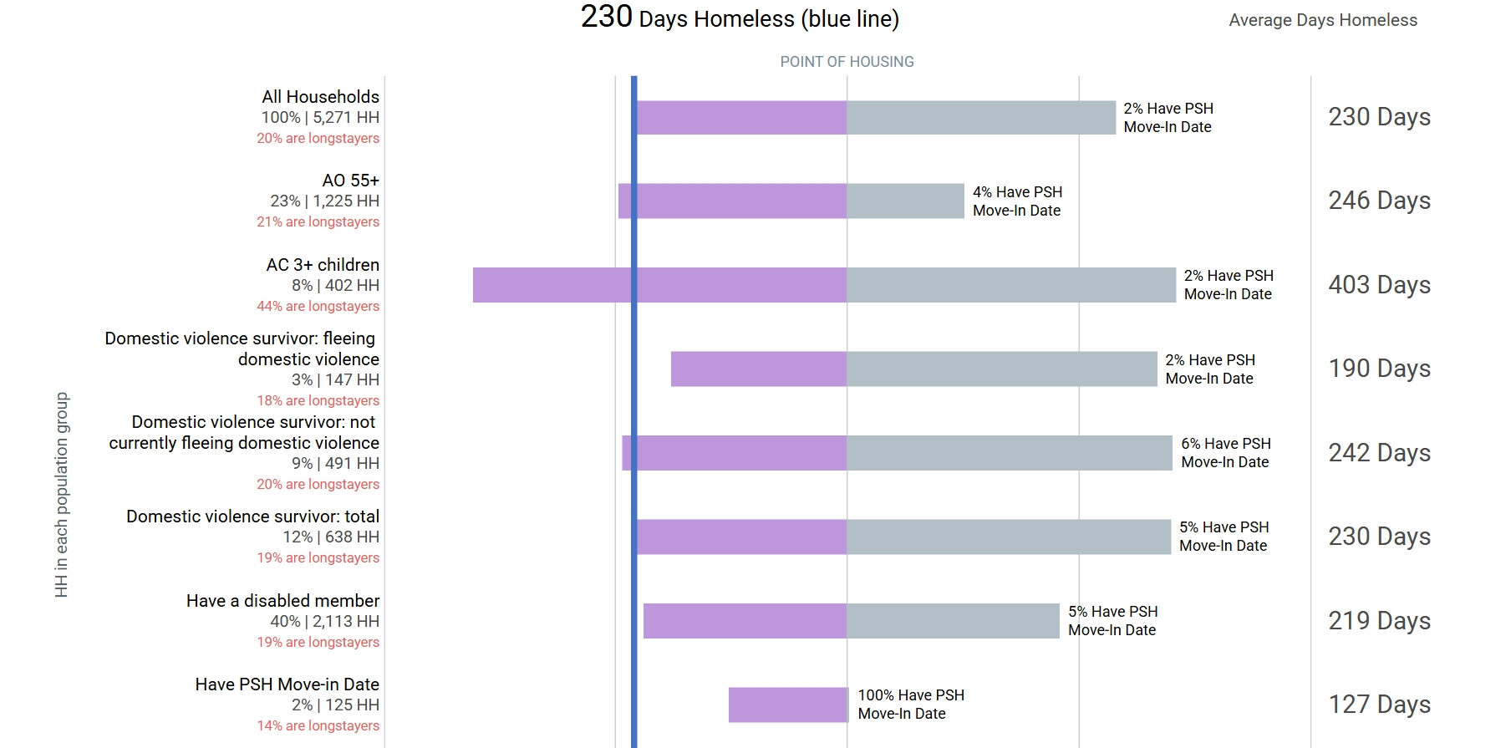
Disability Factors into Homelessness
40% of households experiencing homelessness included a disabled family member

Slide 5
Large Families Struggle to Leave Homelessness
44% of Adults with 3+ Children were long stayers

Slide 6
Aging Adults are Vulnerable
Single adults over age 55 make up 23% of people experiencing homelessness and have the 2nd longest stays (246 days)

Slide 7
Street Outreach Efforts
April 2023 – April 2025
472 Adults were living Unsheltered between April 2023 and April 2025.
320 out of 472 (68%) unsheltered adults are waiting for a CE Assessment
Average Length of time Homeless:
292 days

Slide 8
Coordinated Entry Capacity
Annual Assessment Capacity
265 assessments completed
When fully staffed:
- 2 Case Managers
- 2 CE Specialists
- 6 Outreach Staff
12+ months of homelessness
909 Households
Average length of time from assessment to housing referral: 208.4 days
6+ months
1,407 Households
- 472 Families
- 935 Singles
# of HHs in shelter 12 months or more:
  909 families and singles
# of HH in shelter 6 months or more:
  1407

Slide 9
Housing Need versus Resources
Housing Need
Housing Resources
1407 Households homeless > 6 months
909 Households homeless > 12 months
5,447 Households served in 2024
2,203 Emergency Shelter Units
18 Safe Haven Units
171 Transitional Housing Units
TOTAL Emergency Units = 2,392
_____________________________________
236 Rapid rehousing Units
1,504 Permanent Supportive Housing Units
TOTAL Permanent Units = 1,740
Notes:
5,447 – 4,132 = 1,315
Available units = 236 + 105 PSH turnover
70% of PSH is population restricted. OMH housing requirements are a barrier to presenting households

Slide 10
Total Housing Units Needed
NOTES ON PERMANENT HOUSING
TOTAL UNITS NEEDED: 1,315
  Many existing PSH units are dedicated to specific populations and not generally available (eg. Veteran beds, HIV+ beds, etc.)
  PSH turnover was 7% in FY24: 105 units
  Includes temporary and permanent
  236 RRH + 105 PSH = 341 units of permanent housing available
5,447 Units needed – 2,392 units of Emergency housing – 341 units of available permanent housing = 1,315 units needed

