Slide 1
CoC Orientation
Thanh Pham, MPH
Community Outreach and Support Specialist

Slide 2

Welcome!
Let’s work together to end homelessness on Long Island

Slide 3
What is a CoC?
Acronym CoC – Continuum of Care
A local planning body that coordinates housing and services for people experiencing homelessness in a specific region

Slide 4
How many CoC’s are there?
There can only be 1 CoC within a specific geography
  There are >400 CoCs in the US

Slide 5
What does the lead agency do?
The lead agency is responsible for managing the Homeless Management Information System Database, submit its annual application for funding to HUD, and monitor CoC funded program performance
Responsibilities –
  The lead serves as the liaison to the Federal Government and Local Entities
  The lead manage the database system in which clients are entered in
  The lead assists providers with the Department of Housing and Urban Development (HUD) application process and provides training/support where needed
Long Island Coalition for the Homeless (LICH) is the lead agency to the CoC
The CoC oversees both Nassau and Suffolk Counties on Long Island

Slide 6
Who makes up the CoC?
Housing Providers
  Case Managers
  Shelter Workers
  Street Outreach Workers
  Administrative/Data
Community Based Organizations
Community Members
  Advocates
  Persons with lived experiences
  Local municipalities (i.e. libraries, schools, etc.)
Public Housing Authorities (PHA’s)
Local Government Entities
  Department of Social Services
  Legislators
Faith-Based Organizations

Slide 7
















CoC Funded Programs
Suburban Housing

Slide 8
How do I join/sign up?
Visit our website:
  Lihomeless.org
    Former meeting minutes, committee information, CoC meeting list, etc.
Email Thanh, Community Outreach & Support Specialist – tpham@addressthehomeless.org
  Join the CoC List-serv – receive updates within our region, resources, invitation to our committee meetings, funding opportunities, connect with others who engage or directly work with people experiencing homelessness
  If you would like to present on behalf of your agency (services/resources/etc.), please contact Thanh
The CoC Business Meeting is open to all
  There are no fees associated with joining the CoC and everyone who is a part of the CoC plays an important role in addressing homelessness on Long Island
  Other Subcommittees – CES Case Conferencing Group, Street Outreach Committee, CE Steering Committee, etc.

Slide 9
CoC Organizational Chart
CoC Governance Board
CoC Business Meeting
Subcommittees

Slide 10
CoC Business Meeting (Open Meeting)
General Body Meeting
We meet monthly (via Zoom/Phone)
  Every 3rd Friday of the month (unless indicated otherwise) from 9:00AM-10:15AM
  Minutes are sent out via email and put on our CoC Website: lihomeless.org
Meeting Agenda
  Funding Updates
    Local / State / Federal
    Technical Assistance Updates
  Shelter Updates
    Department of Social Services
  Housing Updates
    Coordinated Entry Teams (LICH CES AND TSCLI CES)
  Data Updates
    HMIS Team
  Events/Trainings
  Resource Sharing + Provider Updates
    Presentations from other providers (services, advocacy/policy, resources)

Slide 11
CoC Governance Board Meeting (Closed Meeting)
Funding Updates
  Local
Voting
  Policy Implementation or Changes
    Assessments/Prioritization, etc.
Operational Changes
  Meeting member slates – nomination process

Slide 12
Subcommittees
CE Steering Committee
  Process for housing prioritization (and who will be served) is determined by this committee and the Governance Board
CES Case Conferencing
  Discuss high barrier cases (chronic shelter clients, street outreach, rapid rehousing programs)
    Trouble-shoot/problem-solve
    Resource sharing
Street Outreach Committee
  Updates with street outreach workers/providers/people that engage with people living on the street
  Resource sharing
  Identify new/highly populated areas
  Committee collaboration
  Point in Time (PIT Count)

Slide 13
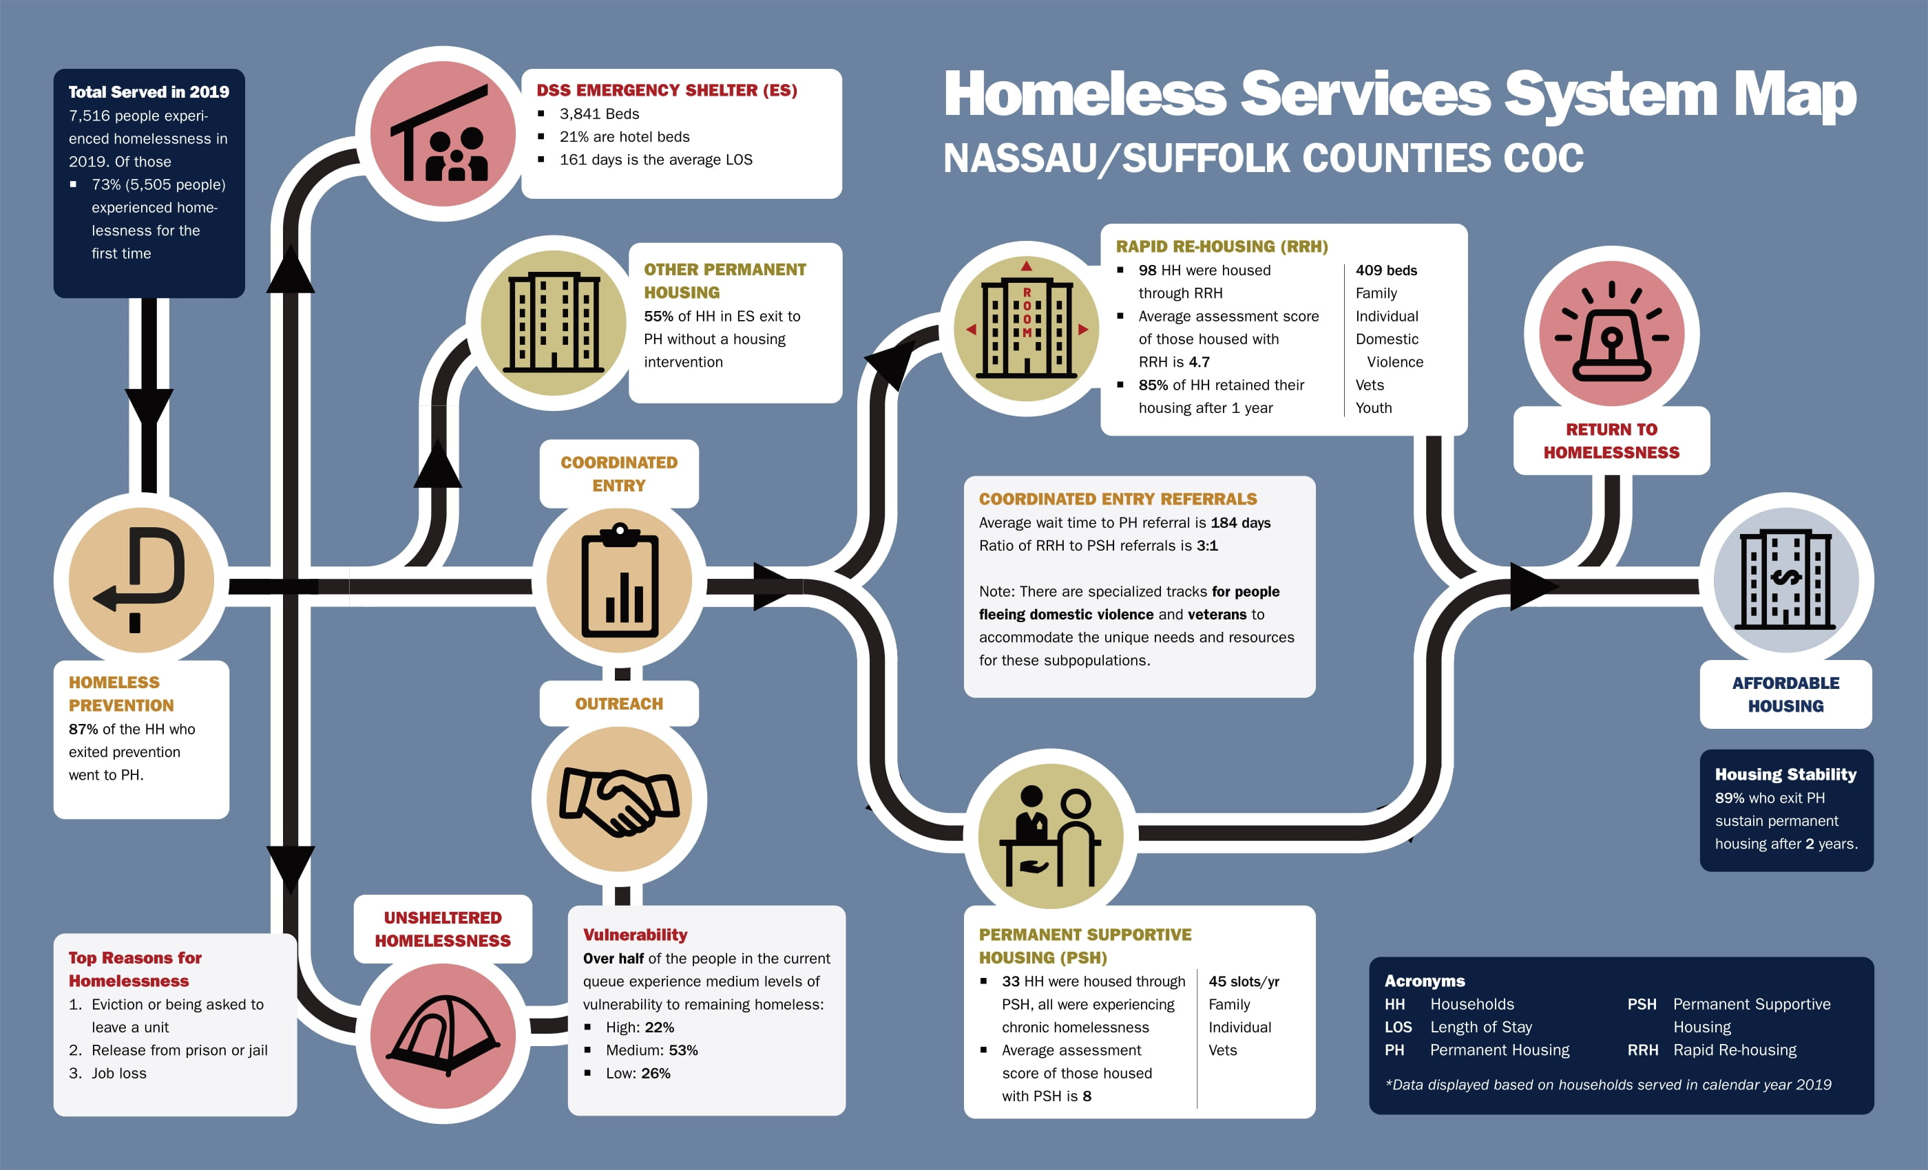
Homeless System on LI

Slide 14
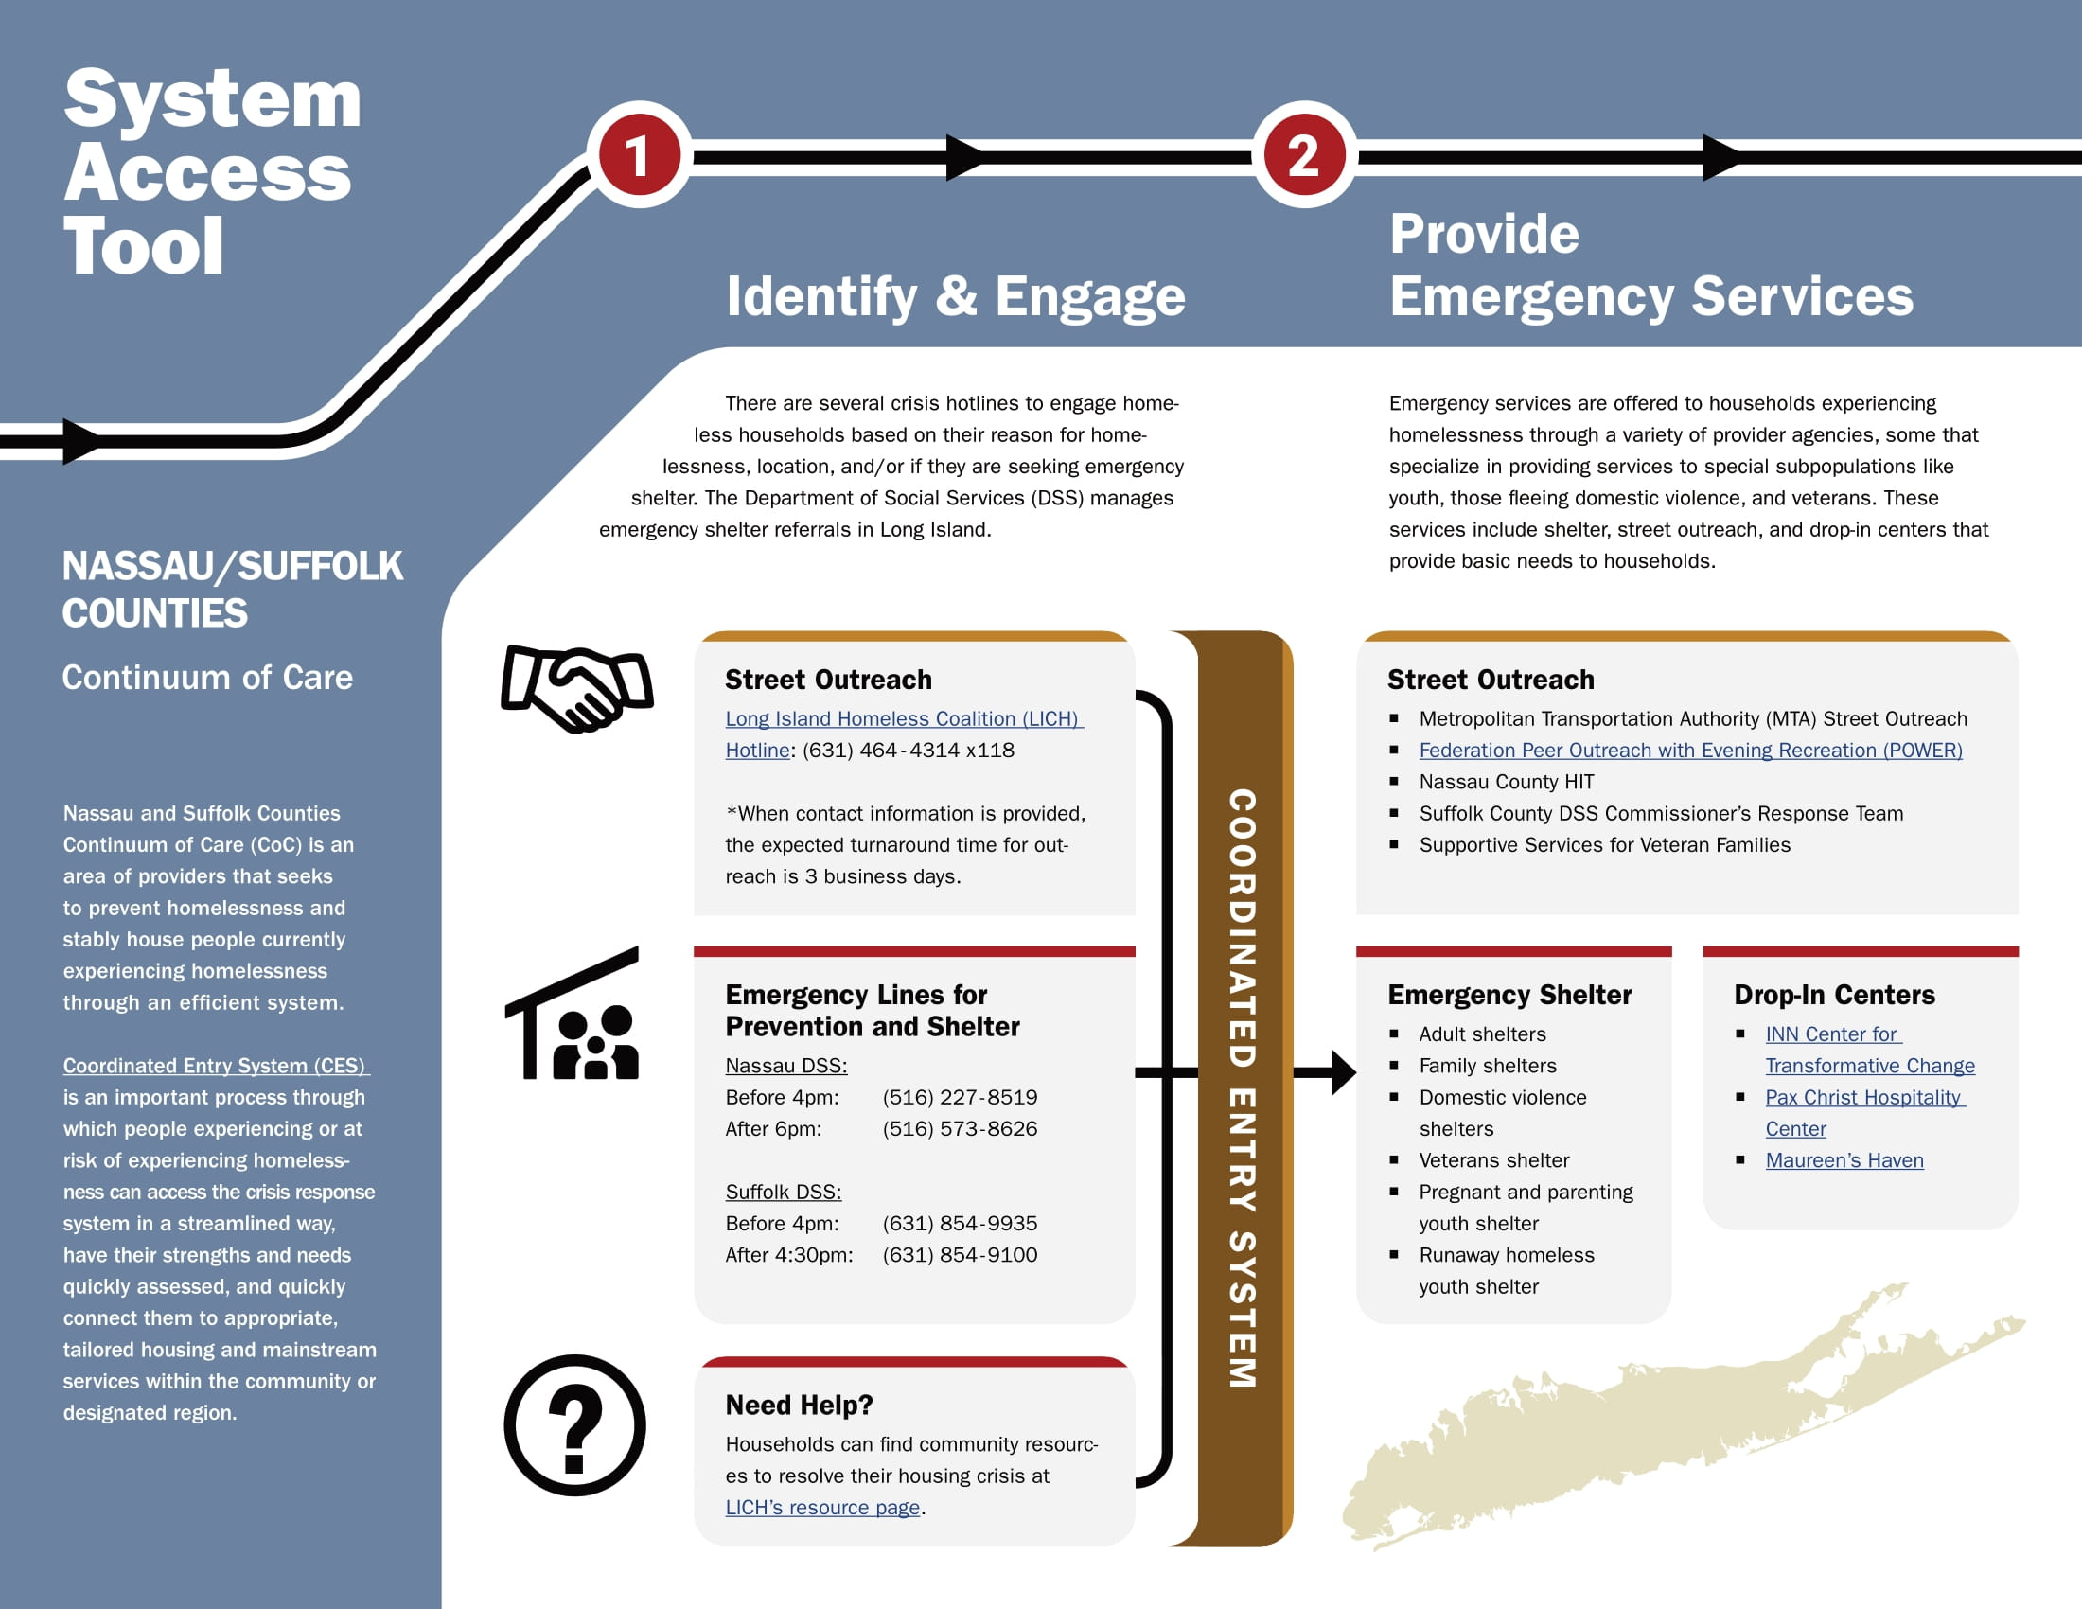

First – Identify and Engage
Second – Connection to Emergency Services

Slide 15
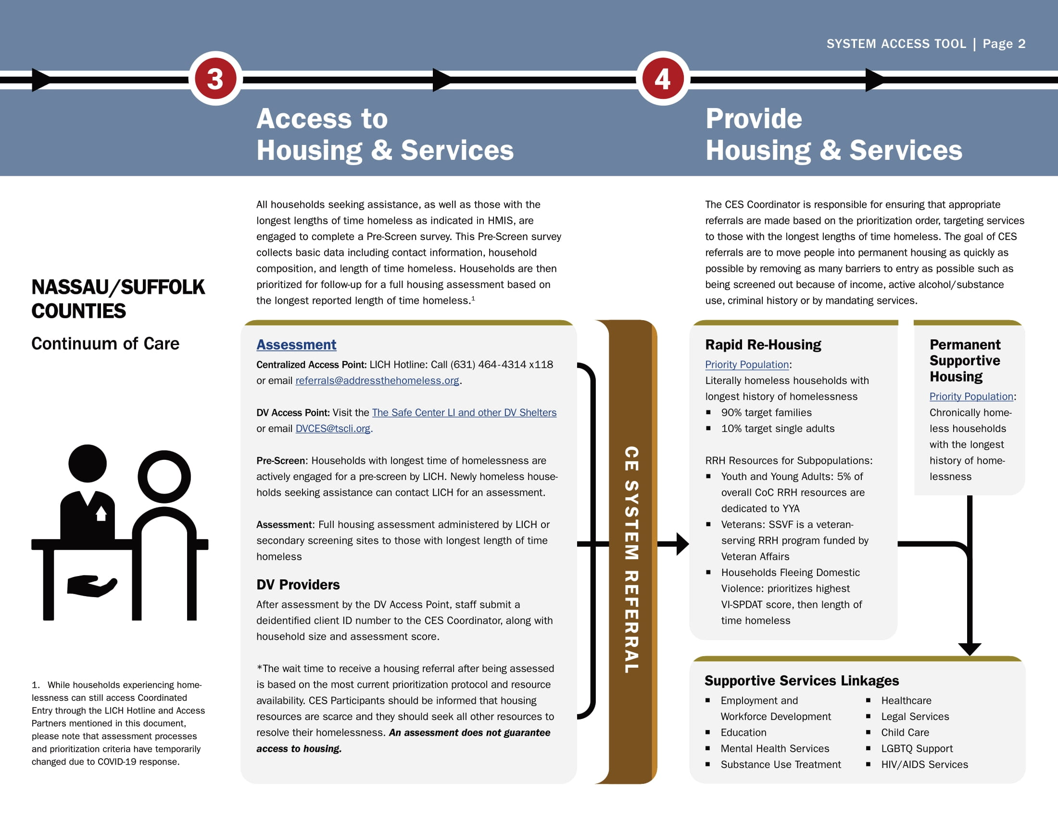
Third – Access to Housing and Services
Fourth – Provide Housing and Services

