Slide 1

FY 2024-2025 HUD Continuum of Care Notice of Funding Opportunity Training
CoC Planning Team, LICH
August 13, 2024

Slide 2

Setting the Stage
This training will be recorded, and all local Funding Round materials will be posted on the CoC website here: https://www.lihomeless.org/coc-nofo
No question is a bad question, but we may not get to all of them! Please use the chat feature. We may need to “parking lot” some questions and conversations and can work one-on-one with applicants that would like more support.
Utilize the HUD guidance available to you (i.e., detailed instructions)

Slide 3

What is a Continuum of Care?
The Continuum of Care (CoC) Program is designed to:
(1) promote community-wide commitment to the goal of ending homelessness;
(2) provide funding for efforts by nonprofit providers, Indian Tribes or Tribally Designated Housing Entities, and local governments.
CoCs cover different areas across the country.
CoC coverage area: Nassau County and Suffolk County
CoC Number: NY-603
CoC website: lihomeless.org

Slide 4

Agenda and Learning Objectives
CoC Foundational Knowledge
Brief Overview of FY 2024-2025 NOFO (local funding round process)
WHO can apply? Eligible Applicants
WHAT can you apply for? Program Types and Populations Served
HOW can you apply? Application Submissions
WHEN do you need to apply by? Deadlines and NOFO Timeframe
WHY apply? Agency decision-making
WHERE can I find out more? HUD and CoC website tour
Other Funding Opportunities
Detailed Application Guidance

Slide 5

CoC Structure
Governing Board
Collaborative Applicant / CoC Planning Staff
CoC Committees
Monitoring and Training
Coordinated Entry System
Homeless Management Information System
CoC Members
CoC Charter on CoC website here: https://www.lihomeless.org/_files/ugd/9fe2eb_08a8ea7b808547bd86a77db50852c664.pdf

Slide 6

Goals of CoC Funding and Strategies
Reducing homelessness through streamlined access to resources, especially for those with the greatest needs and least likely to exit homelessness on their own.
Helping households successfully obtain and maintain housing with minimal barriers
Promoting access to and effective utilization of mainstream programs
Optimize self-sufficiency among those experiencing homelessness
Promoting equity and reducing disparities
Promoting partnerships and leveraging resources

Slide 7

HUD Systems Performance Measures / KPIs
Length of Time Persons Remain Homeless
Housing retention once placed in permanent housing
Total number of homeless persons in your community
Employment and income growth of people in housing programs
First time homeless rates
Successful placement of people on the street into permanent housing
Successful placement and retention rates of people exiting shelters and permanent housing
https://files.hudexchange.info/resources/documents/System-Performance-Measures-Introductory-Guide.pdf

Slide 8
CoC Notice of Funding Opportunity (NOFO)
HUD regulatory document that outlines the competitive funding process that is carried out by local CoCs.
CoC funds are competitive each funding round and not guaranteed but are determined based on local performance ratings and a tiering system, and regional performance.
Projects ranked highest (Tier 1) are guaranteed to be funded if they meet HUD requirements
Projects ranked lowest (Tier 2) are not guaranteed to be funded and will be reviewed for approval by HUD based on the individual application and regional performance of the CoC. In general, the lower a project is ranked in Tier 2, the less likely it is to be funded.

Slide 9

CoC Funding
Annual Renewal Demand (ARD) makes up the majority of the available CoC funding pot. These are projects that have already been approved by HUD, are currently operating, and can reapply to continue operating.
A smaller percentage of funds, become available as new funding opportunities through bonus funds or reallocation.
Bonus funds equal an applied percentage of PPRN/FPRN
Reallocation is the repurposing of funds of existing CoC-funded projects that
CoC Funded Programs
Notes:
FPRN- higher of ARD or PPRN

Slide 10
2023 CoC Funding Breakdowns

Slide 11
CoC Funding- Projected Amounts
Annual Renewal Demand $14,850,568 Existing Projects
CoC Bonus $2,160,000 PSH, RRH, TH-RRH, CE
DV Bonus $2,700,000 RRH, TH-RRH, DV CE
CoC Fund cannot be used for shelters or support services only programs other than Coordinated Entry and HMIS which both have designated entities.

Slide 12
How Projects are Funded through a Local Competition
HUD uses a competitive ranking system, which includes tiers, as a way for CoCs to notify HUD which projects are prioritized for funding based on local needs and gaps.
Tier 1 = 90% Annual Renewal Demand (ARD)
Tier 1 = $13,365,511.20 out of $14,850,568
Tier 2 = Remainder of ARD
New Projects may end up scoring in either Tier
DV Bonus projects are part of a separate set aside request with additional DV narratives that must verify local need.

Slide 13
HUD Ranking Requirements
Objective Criteria
System Performance Measures
Comparable Databases
Severity of Barriers
Advance Racial Equity
Reallocation Strategy
Public Posting

Slide 14
2024 Guiding Principles
Improving HUD Systems Performance Measures / Data-Driven Outcomes
Embracing Key Approaches and Strategies
Ensuring Access and Equity
Meeting Local Unmet Needs
Maximizing Capacity, Funds and Local Impact
Ensuring HUD Compliance and Integral Systems
Detailed Guiding Principles posted on CoC website and included in local application manuals.
https://www.lihomeless.org/_files/ugd/22798f_d56eb8052f3c4e6fa22d251bd239e958.pdf

Slide 15
Local Ranking Criteria (Renewals)
Severity of Needs (who is being served in the program)
Regional New Impact on Homelessness (exits/returns)
Involving People with Lived Experience (narratives)
Data Quality (HMIS or comparable database)
Leveraged resources and supports (chart and narrative)
Project-specific measures on how a program helps people obtain and maintain housing.

Slide 16

New Projects
Leveraging Housing / Healthcare
Local Need
Applicant Experience
Program Design
Appropriateness of Budget
Implementation Plan
Support Services

Slide 17
HUD Review- Tier 2 Projects
100-point scale
50 points for CoC regional score
40 points for project ranking and total Tier 2 funding amount
10 points commitment to housing first

Slide 18
WHO can Apply for CoC Funds?
All renewal projects that have already been approved for funding in the most recent funding round. (ARD)
HUD eligible applicants include:
Nonprofit organizations
Faith-based organizations
States
Local governments
Designated Tribal Nations
Public Housing Authorities
For profit entities are NOT eligible to apply for CoC funds.

Slide 19

Nonprofit Registration through SAM.gov
A UEI is a government-provided number, like a tax ID number, that's used to identify businesses eligible for federal grants, awards and contracts. Note: In April 2022, the federal government replaced its old identifier of choice, the Data Universal Numbering System (DUNS) number, with a government-issued UEI.
https://sam.gov/content/home

Slide 20

CoC Funding Process and Documents
Grant Inventory Worksheet (GIW)
Annual Renewal Demand (ARD) and Preliminary Pro Rata Need (PPRN)
FY 2024-2025 HUD CoC NOFO
FY 2024-2025 HUD CoC NOFO Detailed Instructions- Renewal
FY2024-2025 HUD CoC NOFO Detailed Instructions- New
Local CoC Application for Projects and Guidance Manuals
Local CoC Ranking Scorecards (renewal and new)
Local Priority Listing
CoC Regional Application

Slide 21
WHAT can Eligible Applicants of CoC Funds Apply for?
All renewal applicants can reapply for projects already in operation and/or grants approved in the most recent CoC funding round.
CoC Bonus or reallocation funds can be used for permanent supportive housing, rapid rehousing, transitional housing to rapid rehousing, Coordinated Entry, or HMIS.
Domestic Violence Bonus funds can be used for rapid rehousing, transitional housing to rapid rehousing, or DV Coordinated Entry and must serve households actively fleeing domestic violence.

Slide 22

Eligible Program Models funded through the CoC
Permanent Supportive Housing
Designed for households experiencing chronic homelessness (living on the street or in emergency shelter for one year or longer and with a diagnosed permanent disability).
Rental subsidy where the lease in the provider’s name and households pays 30% of their income towards rent.
Ongoing support services available to obtain and maintain housing.
Program duration is for as long as the household remains eligible and continues to need ongoing support services.
CoC Bonus or Reallocation funds.

Slide 23

Rapid Rehousing Rental Assistance Program
Rapid Rehousing for households experiencing homelessness on the street, in emergency shelter, and/or actively fleeing domestic violence.
Rapid rehousing offers housing search, financial support for moving and rent, and support services until a household can maintain housing on their own.
The lease is in the household’s name and rent assistance is scaled down over time.
Program duration is one a case-by-case basis for up to two years.
CoC Bonus, Reallocation funds, or DV Bonus if serving households actively fleeing domestic violence, with a demonstrated local need.
https://endhomelessness.org/resource/rapid-re-housing-toolkit/

Slide 24
Crisis Housing and Rapid Rehousing Rental Assistance
Joint Component Transitional Housing to Rapid Rehousing for vulnerable populations such as persons unsheltered, youth, or victims of domestic violence that are facing immediate crises to receive immediate crisis housing and then assistance with obtaining permanent rental units.
This program model is not suggested for all CoCs and is most needed in regions without adequate access to emergency shelter where people are experiencing crises on the street.
Locally, there have been challenges implementing this new model.
Program duration is up to two years total between time in temporary crisis housing and rental unit on a case-by-case basis.
CoC Bonus, Reallocation funds, DV Bonus if serving households actively fleeing domestic violence, with a demonstrated local need.

Slide 25

Aligning with Local Needs
Permanent Supportive Housing has been identified as the greatest need in our CoC.
Our local CoC Unmet Needs Survey identified:
persons with disabilities
re-entry
mental health
aging adults
youth
domestic violence
families with children

Slide 26

HOW can you apply for CoC funds?
Local application (attachments, narratives)
HUD esnaps portal
Local Application and completed esnaps application export sent to CoC Collaborative Applicant via email.
https://www.hud.gov/sites/dfiles/CPD/documents/CoC/Accessing-the-FY-2023-Project-Application.pdf
https://www.hud.gov/sites/dfiles/CPD/documents/CoC/Project_Applicant_Profile_Nav_Guide_v2024.pdf

Slide 27
Application FAQs and Step by Step Guidance
HUD FAQ: https://www.hud.gov/sites/dfiles/CPD/documents/CoC/FY2024_Project_Application_FAQs_8-1-24.pdf
HUD Renewal Projects Detailed Instructions: https://www.hud.gov/sites/dfiles/CPD/documents/CoC/FY-2024-CoC-RENEWAL-Application-Detailed-Instructions.pdf
HUD New Projects Detailed Instructions: https://www.hud.gov/sites/dfiles/CPD/documents/CoC/FY-2024-CoC-NEW-Application-Detailed-Instructions-7-31-2024.pdf

Slide 28
Important Considerations
CoC Match Requirements- 25% cash or in-kind
https://www.hudexchange.info/homelessness-assistance/coc-esg-virtual-binders/coc-match/additional-resources-and-links/
Coordinated Entry Participation
https://www.hudexchange.info/homelessness-assistance/coordinated-entry/#coordinated-entry-notice
Current Local CE Prioritization: https://www.lihomeless.org/coordinated-entry-prioritization
Leveraged Housing / Healthcare
CoC meeting presentation recording: https://youtu.be/-jftVtHh26A

Slide 29

Housing First
Housing First (all must be true): Does the project ensure that participants are not terminated from the program for the following reasons?
  Failure to participate in supportive services
  Failure to make progress on a service plan
  Loss of income or failure to improve income
  Being a victim of domestic violence
  Any other activity not covered in a lease agreement typically found in the project’s geographic area

Slide 30

WHEN Do I need to apply by?
August 14: Local CoC applications publicly posted on CoC website and email announcement to full CoC
September 13, 2024: Applications due for submission in esnaps and emailed to LICH with all attachments
September 16-27, 2024: Ranking Committee meets
September 27, 2023: Ranking Committee Recommendations are published
October 4, 2023: Vote on Ranking recommendation/Priority Listing due (via email)
October 4, 2023: Corrections sent to applicants
October 11, 2023: Applications with corrections must be submitted to LICH via esnaps.
October 18, 2023- LICH returns final corrections to applications.
October 18, 2023- Regional application publicly posted for CoC review
October 25, 2024- Final submission by agencies in esnaps.
October 25, 2024: Local applications and regional applications sent to HUD for review
October 30, 2024: HUD deadline to submit regional application, priority listing and all individual applications
HUD Funding Awards (December- April)

Slide 31

Changes from 2023 Funding Round
Tier 1 is set at 90% of Annual Renewal Demand
2-Year NOFO
Funding for specific subpopulations (Domestic Violence bonus, YHDP)
COLAs for conditionally selected grants
Notes:
HUD NOFO P. 4-6

Slide 32

2024-2025 2-Year Funding Round Explained
All renewals with contracts ending in 2025 must apply locally in the 2024 Funding Round. Contracts ending in 2026, do not need to apply locally in 2024, but need to apply in 2025.
The CoC needs to submit a regional application in 2024 but not 2025.
Bonus funds are only available in the 2024 funding round.

Slide 33
WHY Apply for CoC Funds?
Lack of Affordable Housing
Housing is the solution to Homelessness
Mission alignment
Ability to administer federal grants
Expand existing projects to serve more households and more adequately fulfill project budgets

Slide 34

WHERE can I find more information and guidance on the CoC Funding Round?
CoC Competition Landing Page
https://www.hud.gov/program_offices/comm_planning/coc/competition
CoC Funding Round Landing Page
https://www.lihomeless.org/coc-nofo
HUD NOFO Webinar Today 3:30pm-5:00pm
FY24 CoC Program Competition Webinar link

Slide 35

Other Funding Opportunities
HUD Emergency Solutions Grant (ESG)
Empire State Supportive Housing Initiative (ESSHI)
OTDA Solutions to End Homelessness Program (STEHP) and Homeless Housing Assistance Program (HHAP)
HUD HOME/ARP Investment Partnership Program
CoCBuilds

Slide 36

Application Review
  Devil is in the details!
  HUD Detailed Instructions:
  https://www.hud.gov/sites/dfiles/CPD/documents/CoC/FY-2024-CoC-RENEWAL-Application-Detailed-Instructions.pdf
  https://www.hud.gov/sites/dfiles/CPD/documents/CoC/FY-2024-CoC-NEW-Application-Detailed-Instructions-7-31-2024.pdf
  https://www.lihomeless.org/coc-nofo

Slide 37

Local CoC Application Components
E-snaps
External narratives
DEI / Involving Persons with lived experience of homelessness
Leveraging support services
Safety Planning Policies and Procedures (unscored)
Local Documents
Coordinated Entry MOU sign off
Housing First Checklist sign off
Anti-Discrimination Policy sign off

Slide 38

Leveraged Housing Applications
PSH or RRH project that utilizes housing subsidies or subsidized housing units not funded through the CoC or ESG programs.
Private organizations;
• State or local government, including through the use of HOME funding provided through the American Rescue Plan;
• Public Housing Agencies, including through the use of a general or limited preference;
Faith-based organizations; or Federal programs other than the CoC or ESG programs.

Slide 39
Leveraged Housing Requirements
1. In the case of a PSH project, provide at least 25 percent of the units included in the project; or 2. in the case of a RRH project, serve at least 25 percent of the program participants anticipated to be served by the project.
CoCs must attach letters of commitment, contracts, or other formal written documents that demonstrate the number of subsidies or units being provided to support the project.

Slide 40

Leveraging Healthcare Applications
PSH or RRH project that utilizes healthcare resources to help individuals and families experiencing homelessness.
• Direct contributions from a public or private health insurance provider to the project (e.g., Medicaid), and
• Provision of health care services by a private or public organization (e.g., Ryan White funded organization) tailored to the program participants of the project.

Slide 41
Leveraging Healthcare Requirements
1. in the case of a substance use disorder treatment or recovery provider, it will provide access to treatment or recovery services for all program participants who quality and choose those services; or 2. the value of assistance being provided is at least an amount that is equivalent to 25 percent of the funding being requested for the project, which will be covered by the healthcare organization.
Acceptable forms of commitment are formal written agreements and must include:
• value of the commitment, and
• dates the healthcare resources will be provided.

Slide 42

E-snaps Submissions
Program Information
Project Summary Budget
Participants Served PIT / Housing Units
HUD Forms:
Application for Federal Assistance
HUD-2880: Applicant/Recipient Disclosure/Update Report
HUD-50070: Certification for a Drug Free Workplace
Certification Regarding Lobbying
Disclosure of Lobbying Activities
Assurances for Non-Construction Projects
Assurances for Construction Projects
CoC Number NY-603
PSH DedicatedPLUS

Slide 43

Consistency with Consolidated Plan
Each project applicant must submit a certification by the jurisdiction in which the proposed project(s) will be located that the applicant’s project application for funding is consistent with the jurisdiction’s HUD-approved consolidated plan.
For project applications submitted for FY 2024 funding, the Certification of Consistency with the Consolidated Plan Form HUD-2991 must be completed and dated between May 1, 2024, and October 30, 2024.
https://www.hud.gov/sites/dfiles/OCHCO/documents/2991.pdf
https://www.hud.gov/program_offices/comm_planning/conplan#:~:text=The%20Consolidated%20Plan%20is%20designed,%2C%20place%2Dbased%20investment%20decisions.
CPD Mapping Tool: https://egis.hud.gov/cpdmaps/

Slide 44
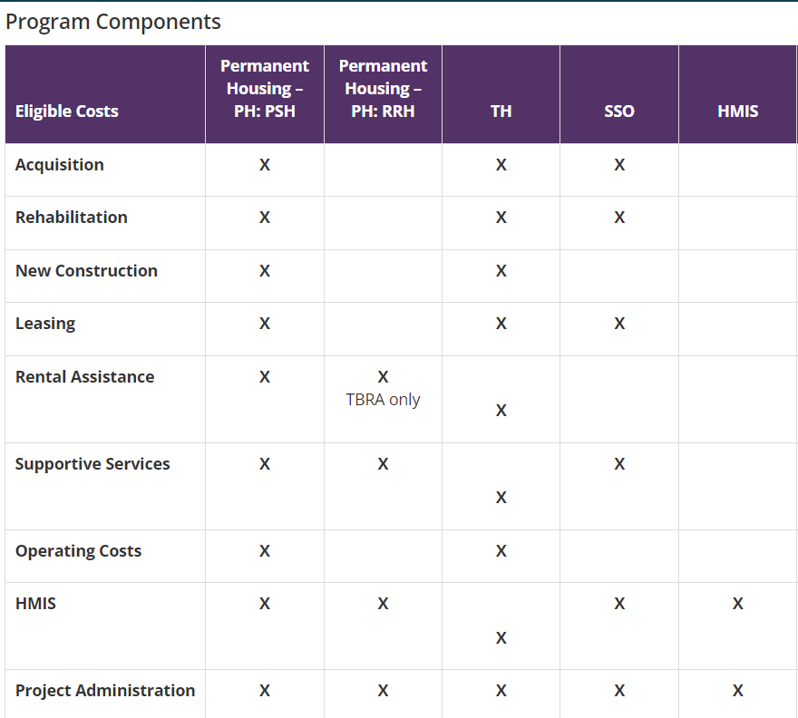
Eligible Expenses for Budgets

Slide 45
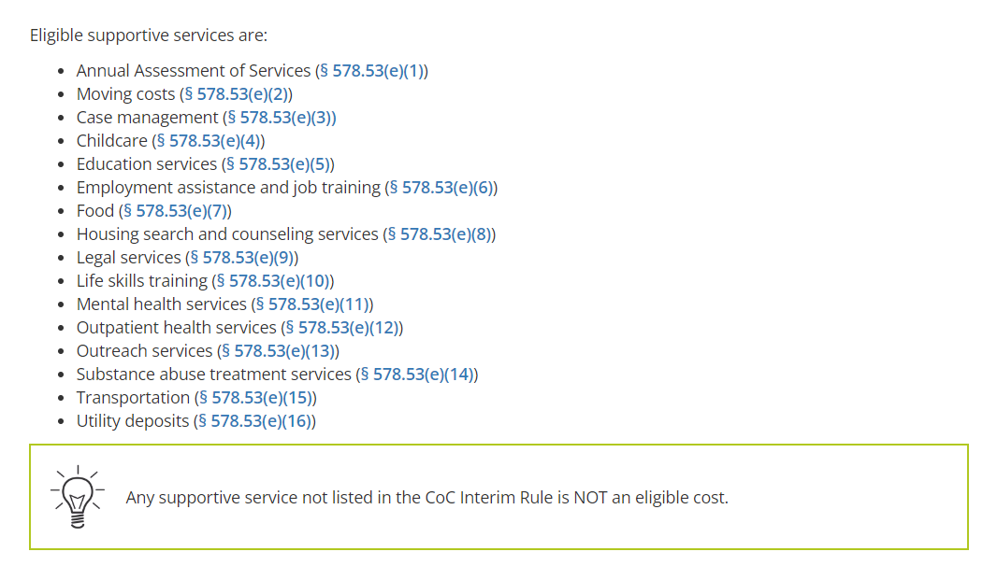
Support Services

Slide 46
VAWA Reauthorization Act of 2022
Examples of eligible costs include the costs of assessing, coordinating, approving, denying, and implementing a survivor’s emergency transfer(s).
Moving Costs. Assistance with reasonable moving costs to move survivors for an emergency transfer(s).
Travel Costs. Assistance with reasonable travel costs for survivors and their families to travel for an emergency transfer(s). This may include travel costs to locations outside of your CoC’s geography.
Security Deposits. Grant funds can be used to pay for security deposits of the safe unit the survivor is transferring to via an emergency transfer(s).
Utilities. Grant funds can be used to pay for costs of establishing utility assistance in the safe unit the survivor is transferring to.
Housing Fees. Grant funds can be used to pay fees associated with getting survivors into a safe unit via emergency transfer(s), including but not limited to application fees, broker fees, holding fees, trash fees, pet fees where the person believes they need their pet to be safe, etc. 39
Case Management. Grant funds can be used to pay staff time necessary to assess, coordinate, and implement emergency transfer(s).
Housing Navigation. Grant funds can be used to pay staff time necessary to identify safe units and facilitate moves into housing for survivors through emergency transfer(s).
Technology to make an available unit safe. Grant funds can be used to pay for technology that the individual believes is needed to make the unit safe, including but not limited to doorbell cameras, security systems, phone, and internet service when necessary to support security systems for the unit, etc.
https://www.lihomeless.org/coc-policies-standards
Available to all awardees!

Slide 47
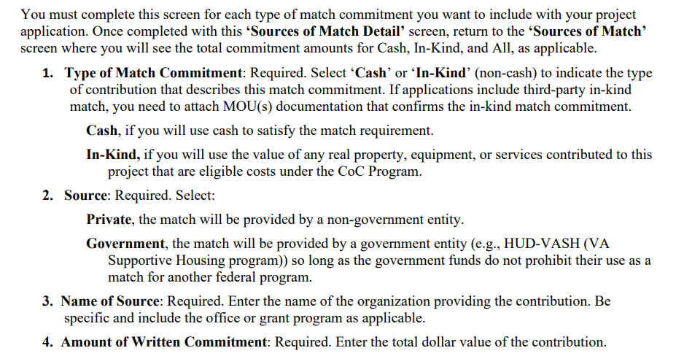
Documenting Match Requirements

Slide 48

Cost Effectiveness / Leveraging
Chart and Narrative on how the project is/will leverage other eligible expenses and support services for project participants from other sources.
New applicants are strongly encouraged to leverage housing or healthcare resources.
https://www.hudexchange.info/programs/e-snaps/coc-supplemental-nofo-to-address-unsheltered-rural-homelessness/coc-program-special-nofo-digest-leveraging-health-care-resources/

Slide 49

DEI / PLE Narratives
Involving people with lived experience on program design, implementation, feedback, and program improvements.
Additionally, how PLEs are compensated for their time and if there are professional development opportunities.
Peer Certified staff?
Identified barriers and solutions to participation of those overrepresented within the local homeless population.
Narratives include NOFO references, definitions, and Race Equity Analysis report for our CoC

Slide 50

Local CoC Documents and Expectations
Coordinated Entry MOU
Housing First Checklist certification
Anti-Discrimination Policy
Policies and procedures on ensuring participant safety
Plan for VAWA funds or other resources
Plan to improve assistance to LGBT+ persons
Housing programs serving families- plan for early education coordination

Slide 51
Summary
A lot of money, not a lot of time
Leveraging of housing and/or healthcare for all new applicants, including DV Bonus
Safety of Tier 2 projects heavily dependent on ability of the region to submit new leveraged housing and/or healthcare applications
Detailed Instruction Manuals
Seek additional guidance
No hard feelings
We are all in this together, we are all a part of the CoC (homeless response system)

