Slide 1





Wayne Scallon, HMIS Administrator, LICH
Mike Giuffrida, Associate Director, LICH
Using Data for Program and System Performance Improvement

Slide 2

What is a “system” of care?
An organizational philosophy and framework that involves collaboration across agencies and community stakeholders for the purpose of improving and expanding the array of coordinated community-based services and access to these services.
A “Systems” Approach to Homelessness:
To end homelessness, a coordinated systems approach is needed.
This approach requires using local data to inform decisions about how to most effectively allocate resources, services, and programs to best address the needs of those experiencing homelessness in the community.

Slide 3





A Coordinated Systems Approach - Key Elements
To address homelessness, communities have moved from a collection of individual programs, to a community-wide response that is strategic and data-driven.
Coordinated Entry – Identify and move those in greatest need to housing faster
Planning – Bring providers, CoC lead, local government, and funders together
Shared Data System – Benefit from a common data system (HMIS)
Collect and Examine Local Data to Inform Decision-Making
Performance Measurement and Evaluation - SPMs
Many communities that have adopted this approach have found that coordination and the use of local data have had a positive impact in their efforts to prevent and end homelessness.

Slide 4


HUD’s Vision for Data and Performance Success
Goals to Improve Data and Performance
Communities use their data to optimize systems of care through making ongoing system performance improvements and determining optimal resource allocation.
Communities operate data systems that allow for accurate, comprehensive and timely data collection, usage and reporting.
Federal government coordinates to receive and use data to make informed decisions in coordination with other data sets, across and within agencies.

Slide 5
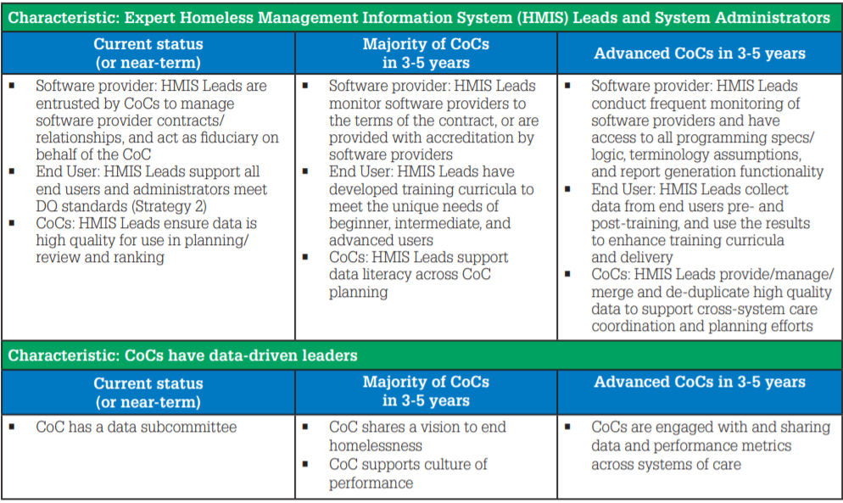
STRATEGY 1:
Improve the capacity of people setting up, operating, and benefitting from data systems

Slide 6
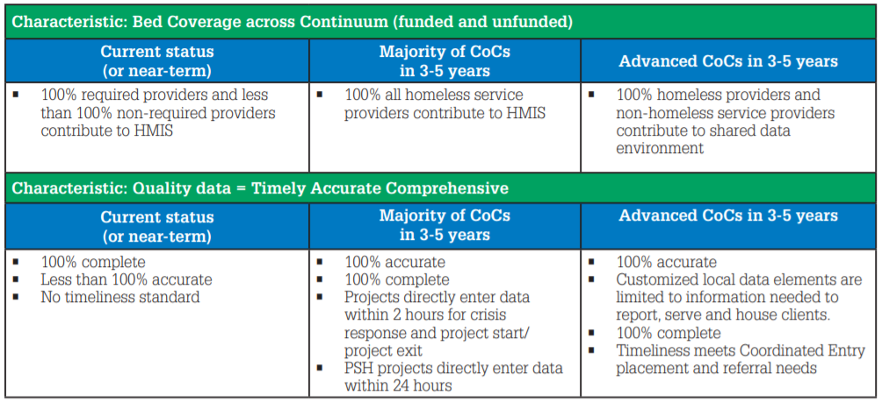
STRATEGY 2:
Data systems collect accurate, comprehensive and timely data

Slide 7
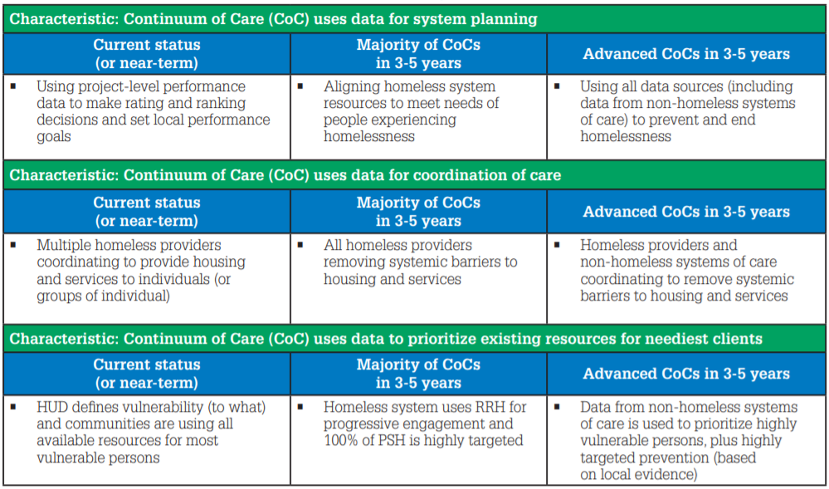
STRATEGY 3:
Continuums and stakeholders use data to improve efforts to end homelessness

Slide 8
Using a Regional By-Name List as a System Driver
Is the geographic coverage of your outreach clearly mapped out, informed by your data and regularly assessed to ensure you reach all unsheltered individuals within your community?
Have you coordinated your outreach, ensuring that your teams are deployed at locations and at times mostly likely to effectively engage unsheltered homeless individuals, while minimizing duplication between providers?
Do you have a documented outreach policy that clearly states how your outreach teams will be deployed and how they work with each other to swiftly connect individuals to housing?

Slide 9
Difficult to Track Populations
People cycling in and out of homeless and institutional settings such as hospitals, treatment centers, or jail. (Most commonly street homeless use ER)
People living in cars, or other highly transient street homeless that move from location to location.
People relocating from other regions and presenting as homeless here.

Slide 10
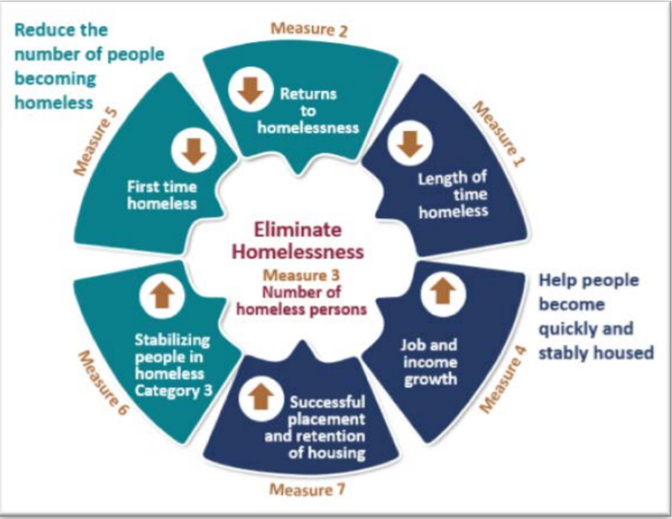
SPM
System Performance Measures:
Helping us understand the effectiveness of our system
The Big 3:
Measure 1 – Length of time homeless
Measure 2 – Returns to homelessness
Measure 7 – Successful placement and retention of housing

Slide 11
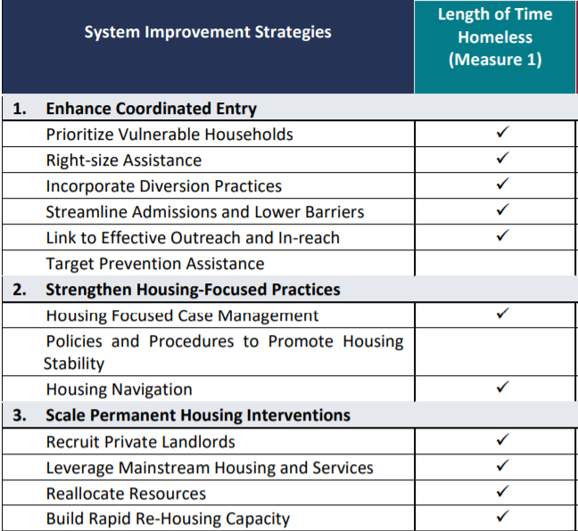
SPM
System Performance Measures
Measure 1: Length of time people remain homeless
Goal:
Reduce the average and median length of time that clients remain homeless in ES, SH, TH.
Data Quality Assessment:
Failing to exit clients will have the biggest negative impact on this measure.
Inaccurate entry of ‘Approx Date Homelessness Started’ information can significantly impact this measure.

Slide 12
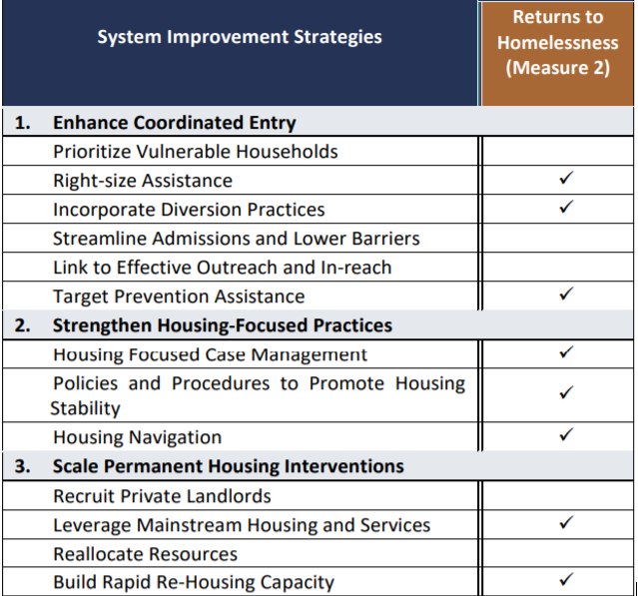
SPM
System Performance Measures
Measure 2: Returns to homelessness
Goal:
Reduce the % of returns to homelessness after exits to permanent housing destinations.
Data Quality Assessment:
Misidentifying exit destinations as permanent can have a negative impact on this measure.
Failure to enter entry and exit dates accurately can impact this measure.

Slide 13
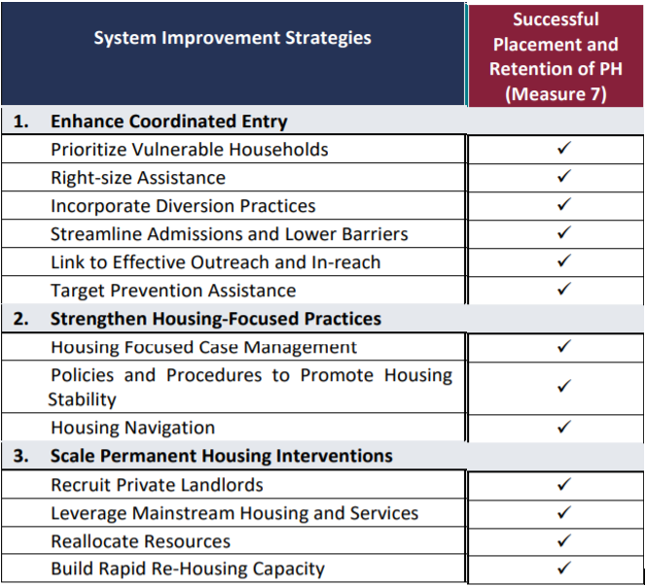
SPM
System Performance Measures
Measure 7: Successful placement/retention
Goal:
Increase the % of people who exit to a sheltered or permanent destination, or stay in permanent housing.
Data Quality Assessment:
Misidentifying exit destinations will have a negative impact on this measure.
HUD recognizes that certain project types will have greater success in moving people to permanent destinations than others.

Slide 14
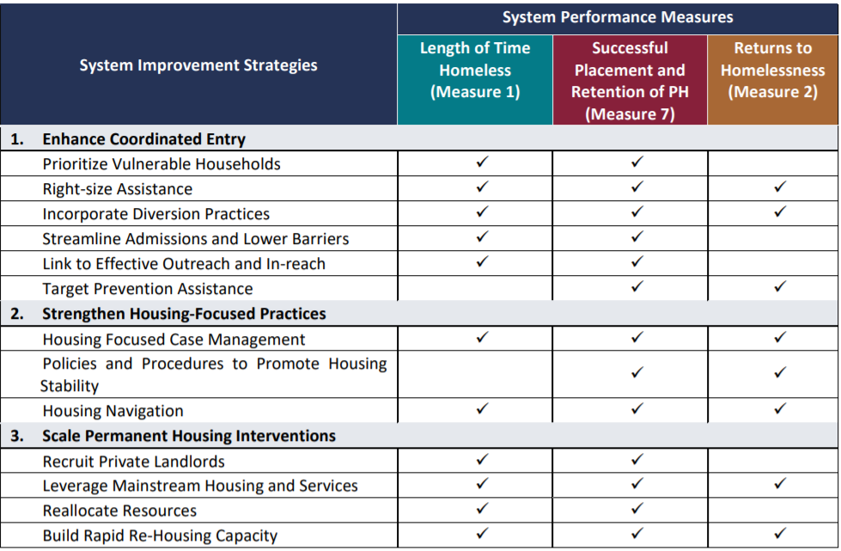
System Improvement Strategies for the 3 Key SPMs
Fully implement Coordinated Entry.
Provide immediate supports to solve housing crises and promote housing stability.
Optimize local resources and expand permanent housing options.

Slide 15
Local Trends Related to Data Tracking/Performance
The good…
Veterans, youth, families with children, domestic violence, street homeless
The bad…
Aging adults, single females, re-entry, motel stayers, first-time homeless, relocating from other areas, at-risk of homelessness
The ugly…
Average length of time people experience homelessness (trauma)
Retention rates of Vietnam-era veterans and severely disabled street homeless
Acceptance of housing/services (street, motel stayers)

Slide 16
Measuring Outcomes
(Veterans and Chronic Homeless)
INFLOW (monthly)
OUTFLOW
People becoming homeless for the first time
People returning to homelessness after temporary institutional stay
People returning to homelessness after being permanently housed
People that were missing but now found to be still homeless, or became homeless again
People exiting homelessness through a program referral or intervention
People exiting homelessness on their own (most commonly to live with family/friends)
People entering an institution for extended periods of time (i.e. 6 year prison sentence)
People becoming inactive/missing after 90 days of unknown whereabouts
“Functional Zero” (veterans, chronic homeless)

Slide 17
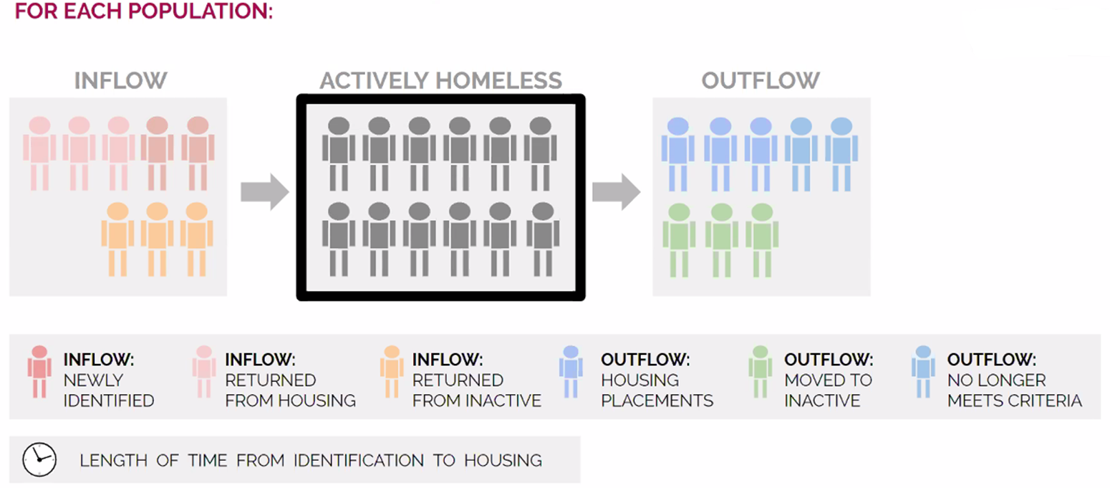
INFLOW → OUTFLOW TRACKING

Slide 18

System vs. Project
Performance Evaluation at Macro and Micro Level
Understanding system performance is a broader task than the CoC merely running a SPM report annually.
A CoC must regularly evaluate project-level performance by looking at individual outcomes such as exits to and retention of permanent housing, length of stay in the project, length of time to housing move-in, increases in income, and of course, overall HMIS data quality.
Assessing performance at the system level is important and necessary, but to identify what needs improvement, communities must continue to evaluate project performance.

Slide 19
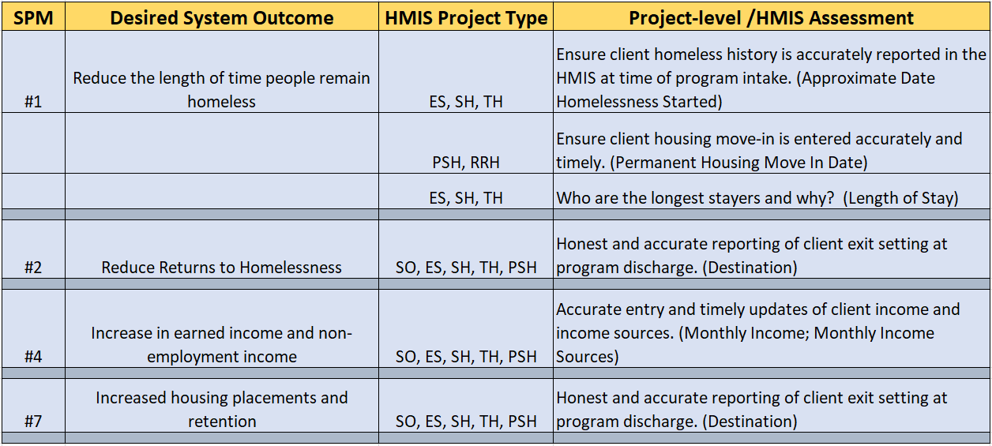
HMIS Project Level Assessment
Evaluating HMIS Data for Improved System Outcomes

Slide 20

Questions?

Slide 21
Resources
HUD Exchange
www.hudexchange.info
HUD Continuum of Care Program
www.hudexchange.info/programs/coc/
HUD Homeless Management Information System (HMIS)
www.hudexchange.info/programs/hmis/
HUD System Performance Measures
www.hudexchange.info/programs/coc/system-performance-measures/#guidance
United States Interagency Council on Homelessness
www.usich.gov

